Slide 1
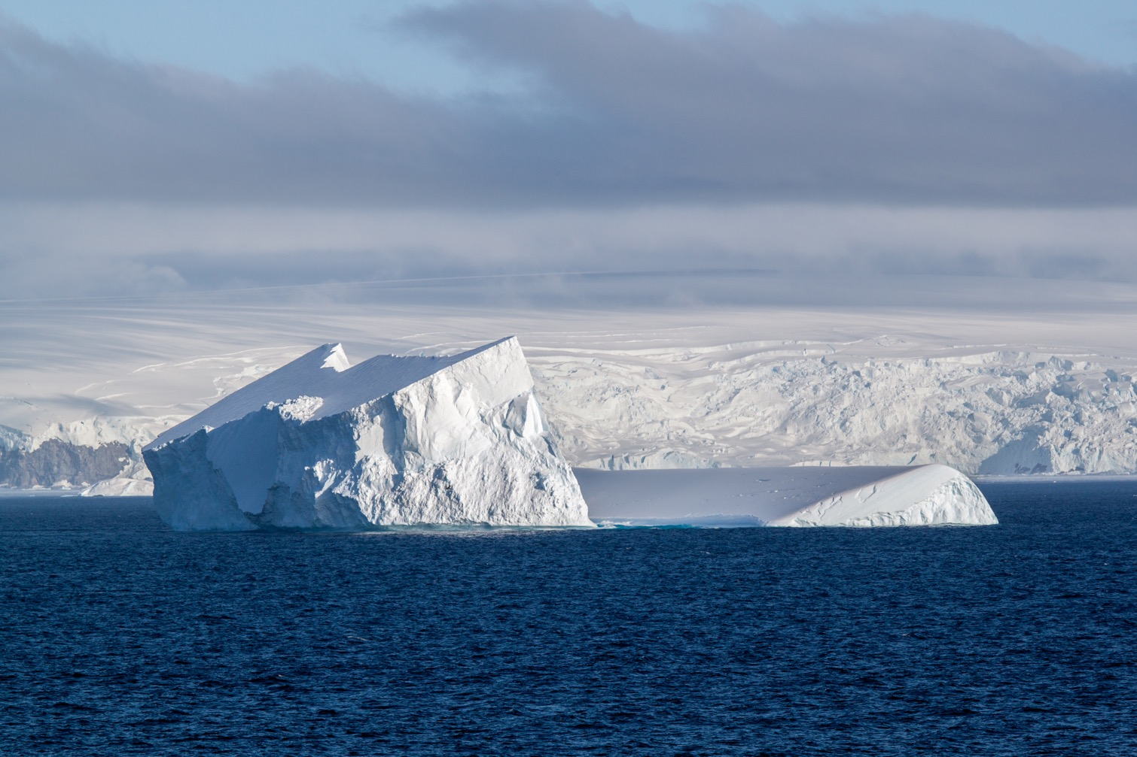
Meeresspiegel im Wandel
– Eis und der lange Atmen der Klimaveränderungen –
Prof. Dr. Olaf Eisen
Glaziologe
AWI Bremerhaven &
Universität Bremen
REKLIM Regionalkonferenz
28 September 2023
Bremen

Slide 2
Polarforschung im 21. Jahrhundert
– neue Fortschritte, gebliebene Herausforderungen –
Kalt.
Dunkel.
Lebensfeindlich.
Weit.
Warum fahren dort hin?
Es ist dringend!

Slide 3
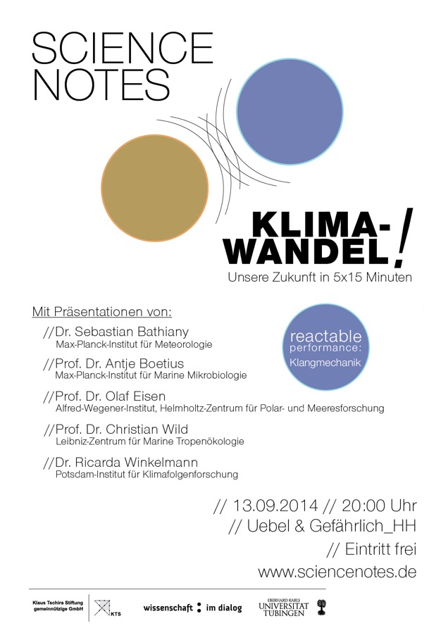
  Meeresspiegel im Wandel
  – Eis und der lange Atmen der Wissenschaft –

Slide 4
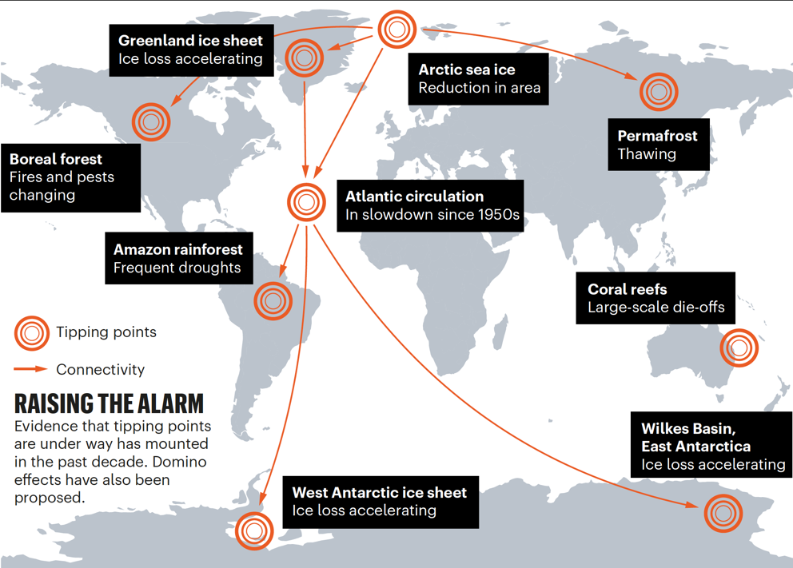
Warum? Kipppunkte im Klimasystem
Was kostet
die Versicherung des Klimas?
risk = probability x damage
emergency = risk x urgency
= risk x
E = R × U = p × D × τ / T
If reaction time is longer than the
intervention time left (τ / T > 1),
we have lost control.
Lenton et al., 2019
reaction time_
intervention time
Notes:
From insurance: do the maths
Overarching question: how close are we to an emergency?
The situation is an emergency if both risk and urgency are high.
Urgency (U) is defined in emergency situations as reaction time to an alert (τ) divided by the intervention time left to avoid a bad outcome (T).
If reaction time is longer than the intervention time left (τ / T > 1), we have lost control.

Slide 5
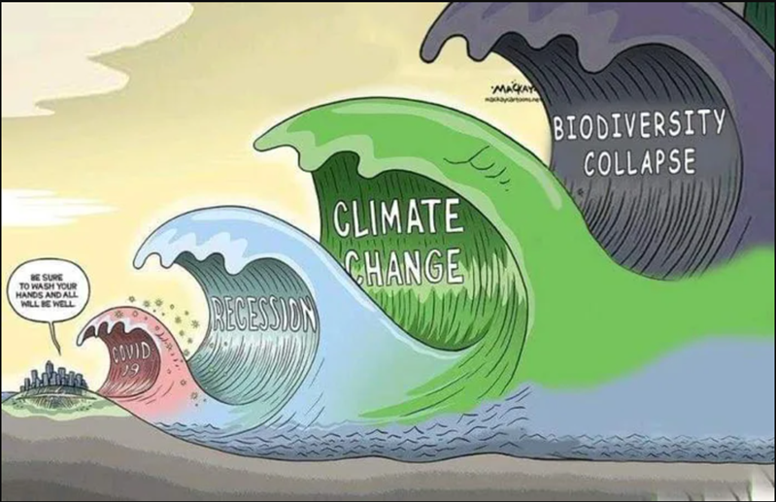
Was bedeutet „Kontrolle verlieren“?
BE SURE TO
WASH YOUR
HANDS AND ALL
WILL BE WELL.

Slide 6
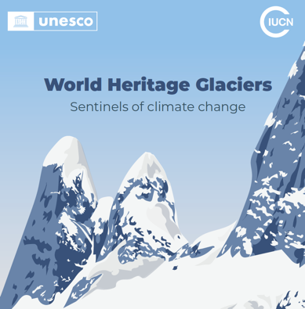
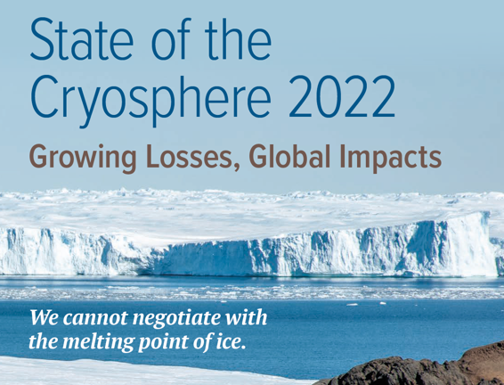
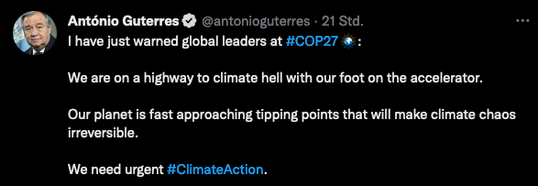

Wo stehen wir?
IPCC AR6 synthesis report, March 2023
A.4
Policies and laws addressing mitigation have consistently expanded since AR5. Global GHG emissions in 2030 implied by nationally determined contributions (NDCs) announced by October 2021 make it likely that warming will exceed 1.5°C during the 21st century and make it harder to limit warming below 2°C. There are gaps between projected emissions from implemented policies and those from NDCs and finance flows fall short of the levels needed to meet climate goals across all sectors and regions. (high confidence)
C.1
Climate change is a threat to human well-being and planetary health (very high confidence). There is a rapidly closing window of opportunity to secure a liveable and sustainable future for all (very high confidence). Climate resilient development integrates adaptation and mitigation to advance sustainable development for all, and is enabled by increased international cooperation including improved access to adequate financial resources, particularly for vulnerable regions, sectors and groups, and inclusive governance and coordinated policies (high confidence). The choices and actions implemented in this decade will have impacts now and for thousands of years (high confidence).
November 2022 vor COP27: Aktualisierungen und neue Berichte

Slide 7
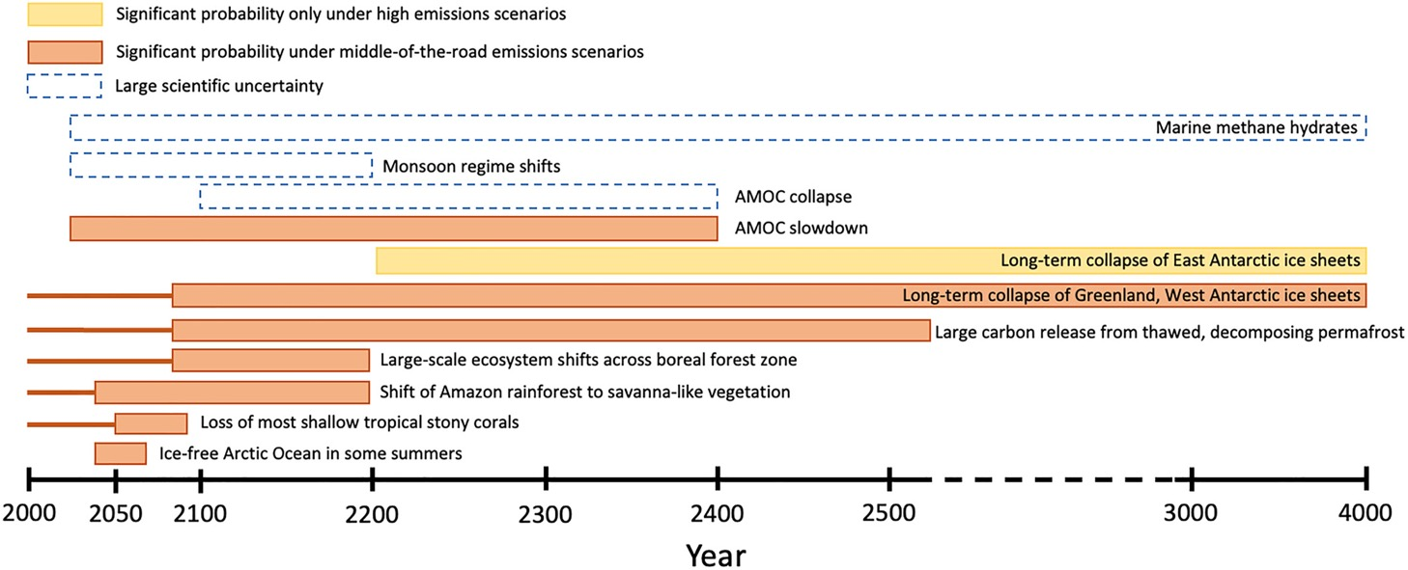
Warum müssen wir langfristig denken?
vermutlich bereits verpflichtet
Want et al.,2023

Slide 8
Was ist schief gelaufen?
Unzureichende Maßnahmen gegen Klimawandel …
Lobby-Gruppen der Fossilindustrie agieren gegen effektive Maßnahmen (merchants of doubt)
Politik profitiert und agiert populistisch
Medien versagen bei der Aufklärung
Wissenschaft war zu zaghaft und aufrichtig
Gesellschaft weiterhin unklar über das sich entfaltende Drama & Tragweite

Slide 9
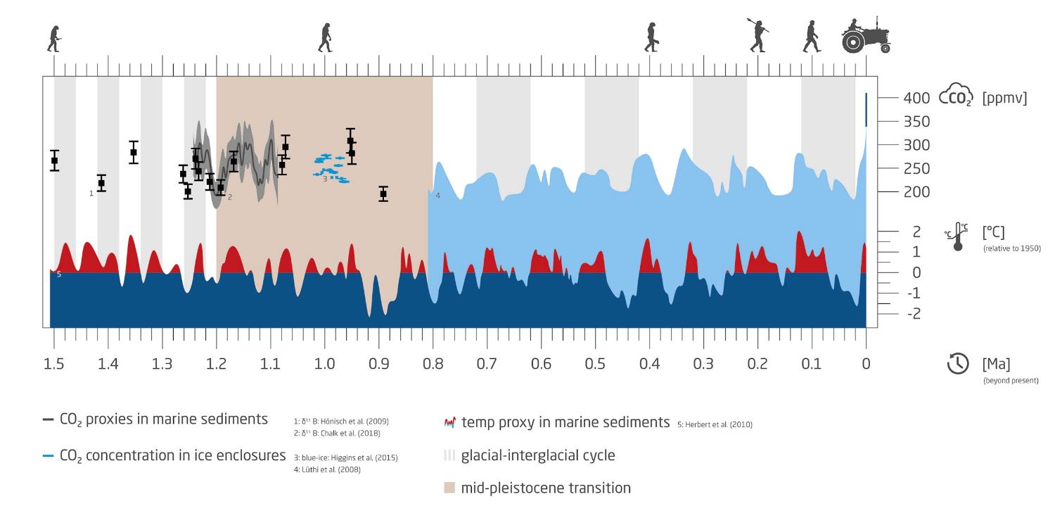

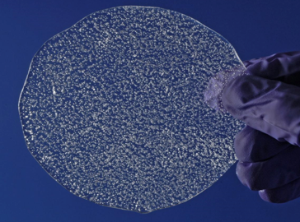
Warum sind Eisschilde wichtig?
Einzigartiges Archiv des Paläoklimas
heute:
424 ppm
?
EPICA ice core, Concordia station
Notes:
Mid-Pleistocene transition

Slide 10

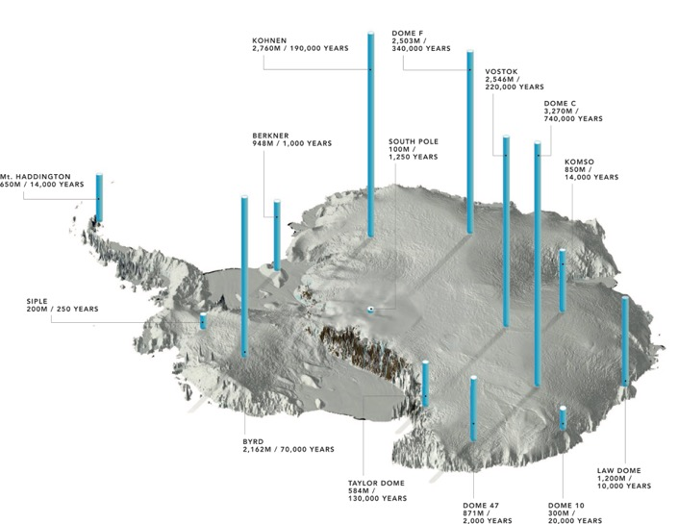
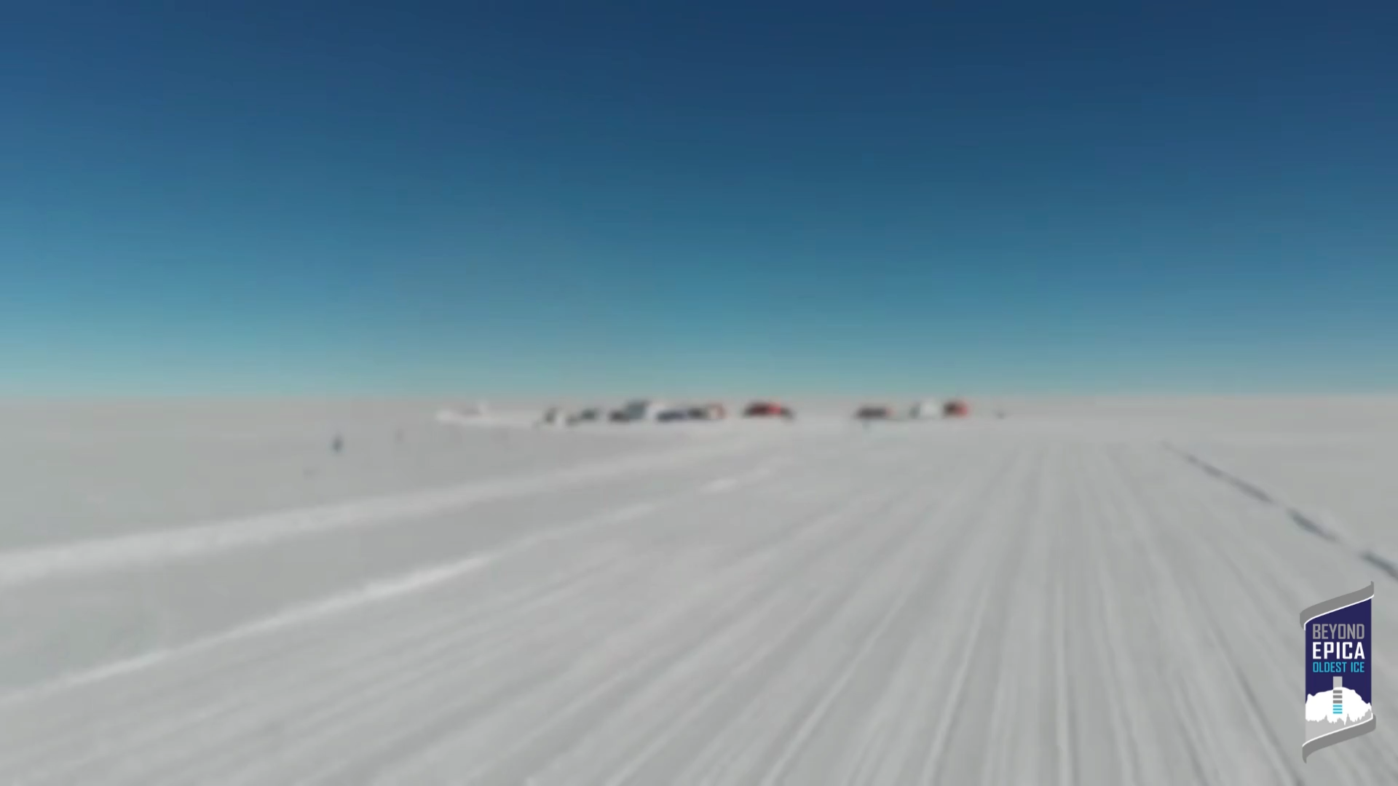
Beyond EPICA, Little Dome C, Antarctica
Elevation: 3233 m
Ice thickness: 2764 m
Age: >1,200,000 years
Pre-site survey: 2017 – 2020
Ice-core drilling: 2021 – 2025
Scientific analysis: 2026 – 2030
Working conditions: Nov. – Jan.
(–50 to –35 ºC)
Fretwell, 2020

Slide 11
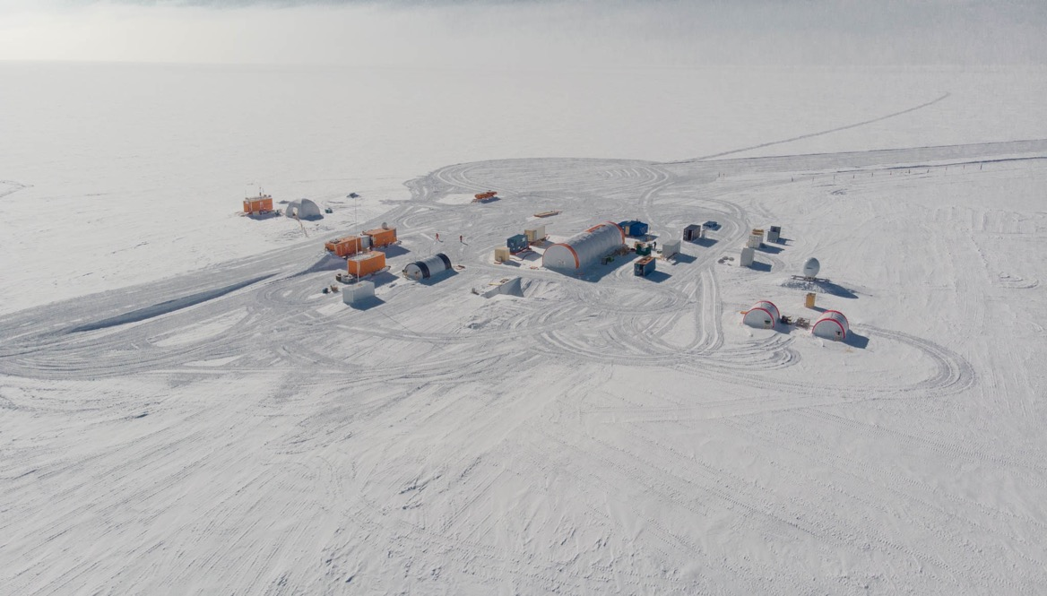













Beyond EPICA – Oldest Ice
Solving a challenging enigma in Earth‘s climate.

Slide 12
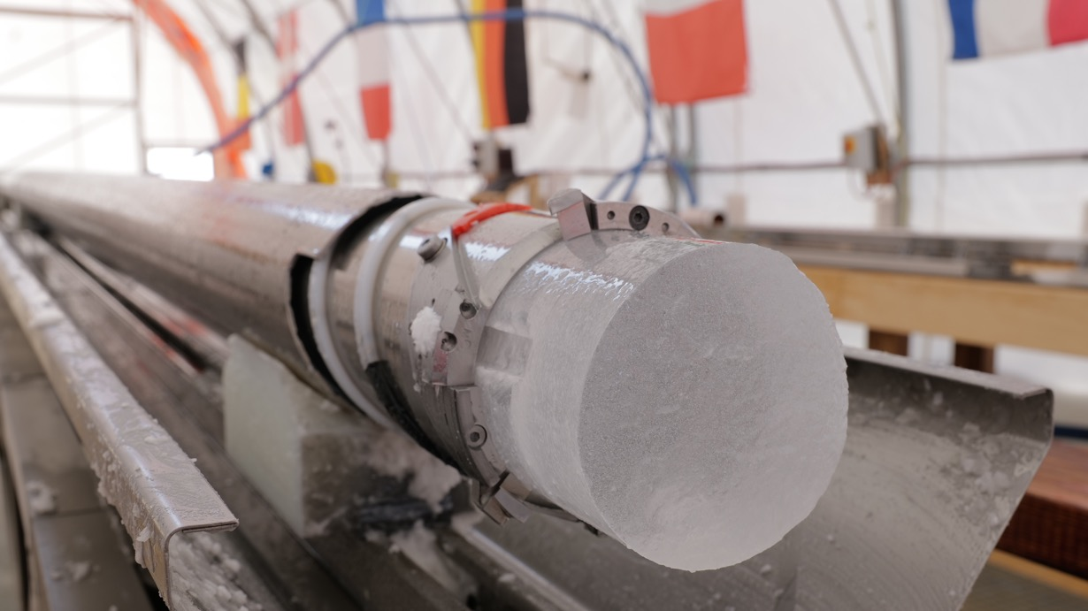
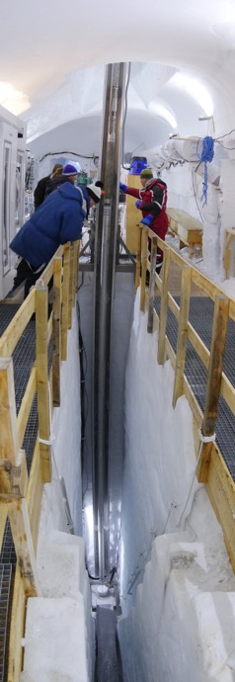
Eiskernbohrung
EastGRIP, Greenland Beyond EPICA, Antarctica

Slide 13
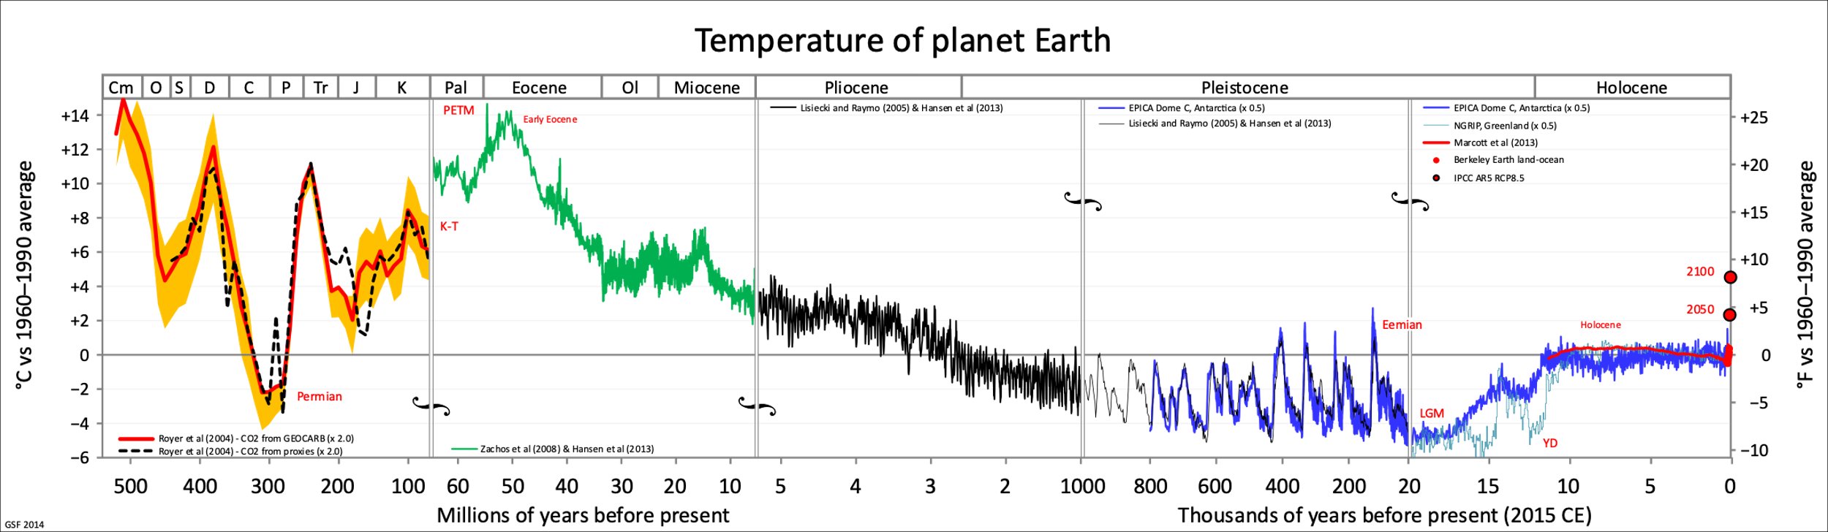
Eine kurze Geschichte des Erdklimas
Fergus, 2021
Planetare Grenze für Menschen
?
?
+70–76 m
+5–25 m
+6–13 m
+5–10 m
Meeresspiegel aus Paläorekonstruktion bzgl. 1900 (IPCC AR6)

Slide 14
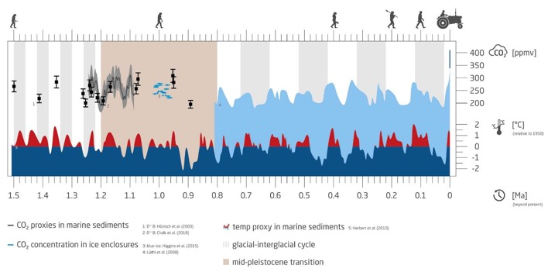


Warum sind Eisschilde wichtig?
1. Paläoklima
2. Meeresspiegel
Antarctic
ice dynamics
    Richtige Interpretation & Vorhersagen:
    Verständnis der Eisdynamik (wie schnell?)
    Wissen über Eiseigenschaften und Randbedingungen
?
ice cores: direct access
Beyond EPICA, 2019
Slater et al., NCC, 2020
Notes:
For both aspects important: which properties does the ice have?

Slide 15
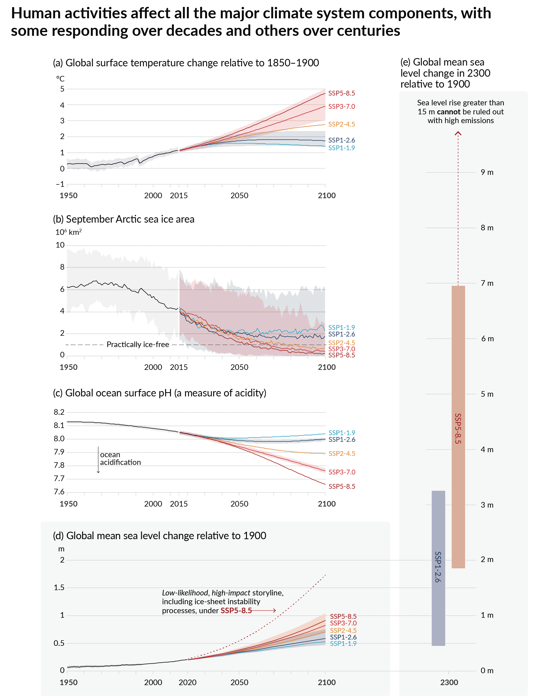
Warum sind Eisschilde wichtig?
Meeresspiegeländerung
(bzgl. 1900)
Unsicherheit
Antarktisches Eisschild
?
Direkte Auswirkung auf 630 Millionen Menschen
Beobachtungen
IPCC, AR6, 2021
Notes:
Tthis uncertainty is smaller than that for all economic/social decisions being made

Slide 16
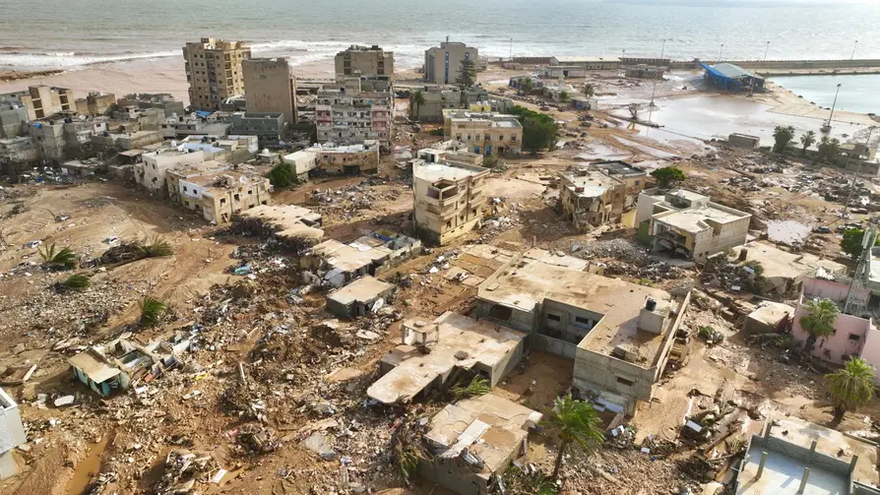
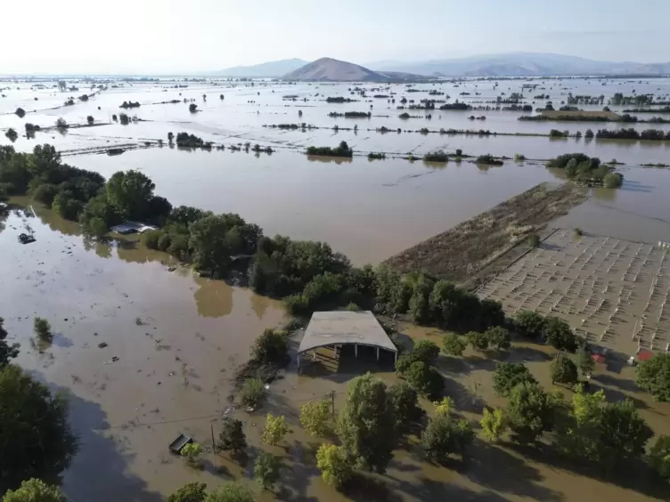
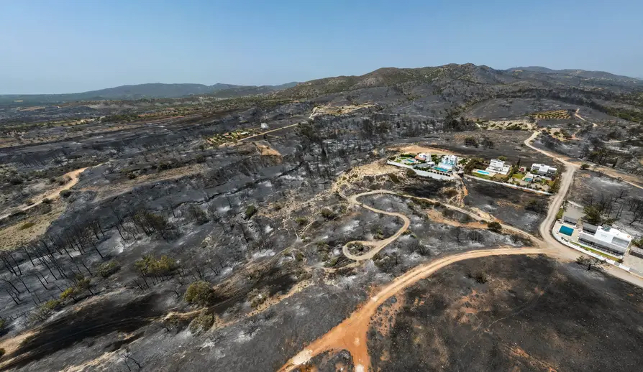
Einzelereignisse – kumulierte Effekte low likelihood
Quelle: RND, DPA (Vaggelis Kousioras), RND

Slide 17
Warum müssen wir langfristig denken?
Entscheidend für Meeresspiegelanstieg
vermutlich bereits verpflichtet
Want et al.,2023

Slide 18
Klimawandel = Klimakrise
10 word-summary on recent knowledge
(Anthony Leiserowitz, Yale University, Co-Author IPCC/GIEC AR6 WGI)
It's real.
It's us.
Experts agree.
It's bad.
There's hope.

Slide 19
In der Zukunft
    Klimawandel …
    wird bestimmen, wie wir leben werden,
    Biodiversitätsverlust …
    ob.
Wir müssen die Kontrolle behalten!

Slide 20
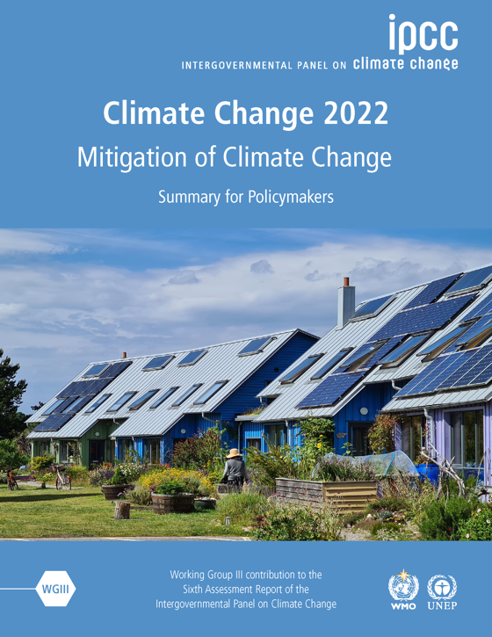
Lösungsmöglichkeiten sind vorhanden!
Alle Sektoren notwendig:
Energie
Transport
Bau & Städte
Industrie
Landwirtschaft, Nahrung, Abfall
naturbasierte Lösungen

Slide 22
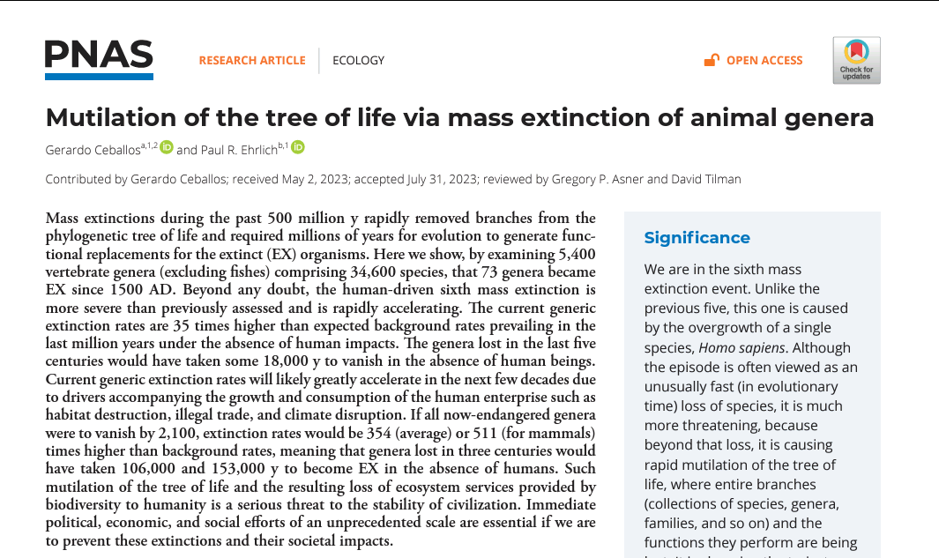
Biodiversitätsverlust

Slide 23
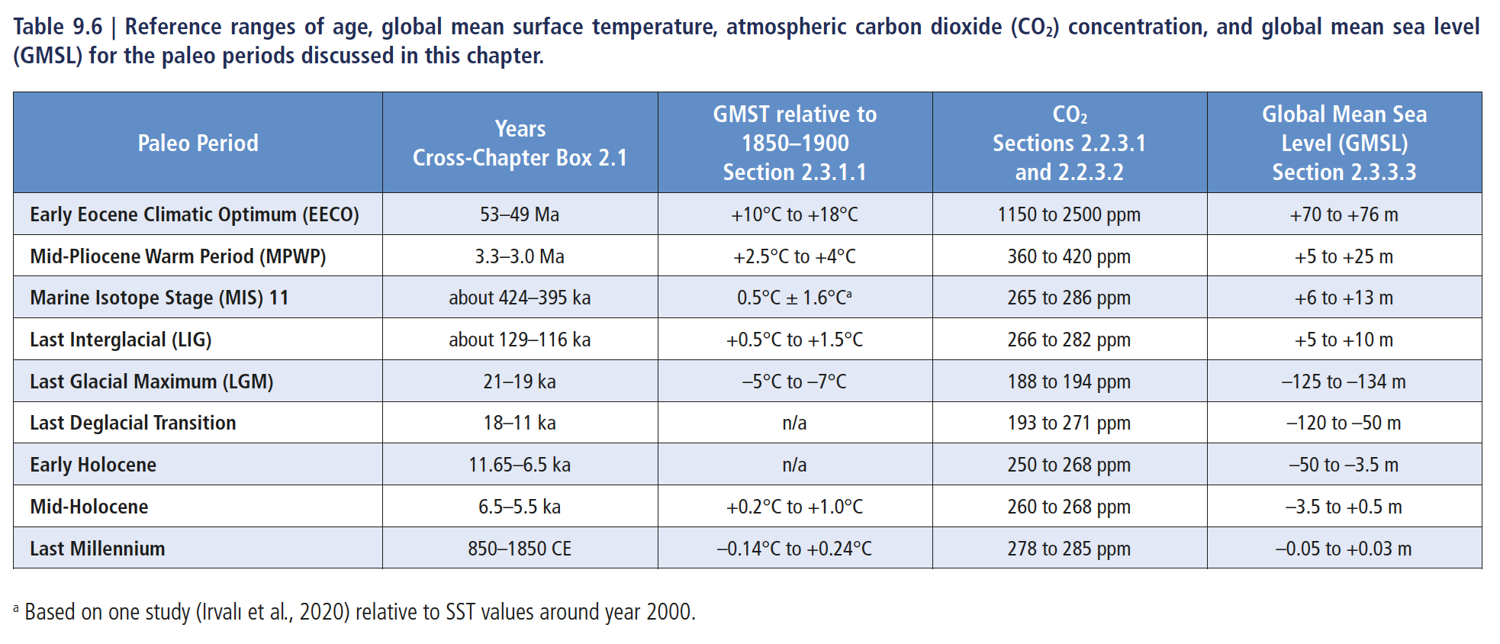
Notes:
Fig 9.2
Tab 9.6
SROCC SPM p38
AR4 SLR-curve 6.8

Slide 24
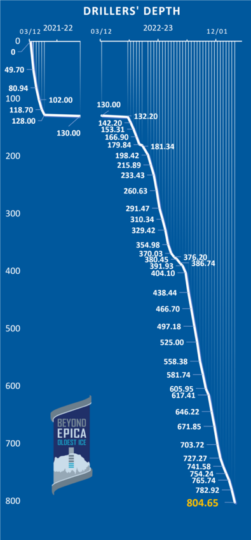
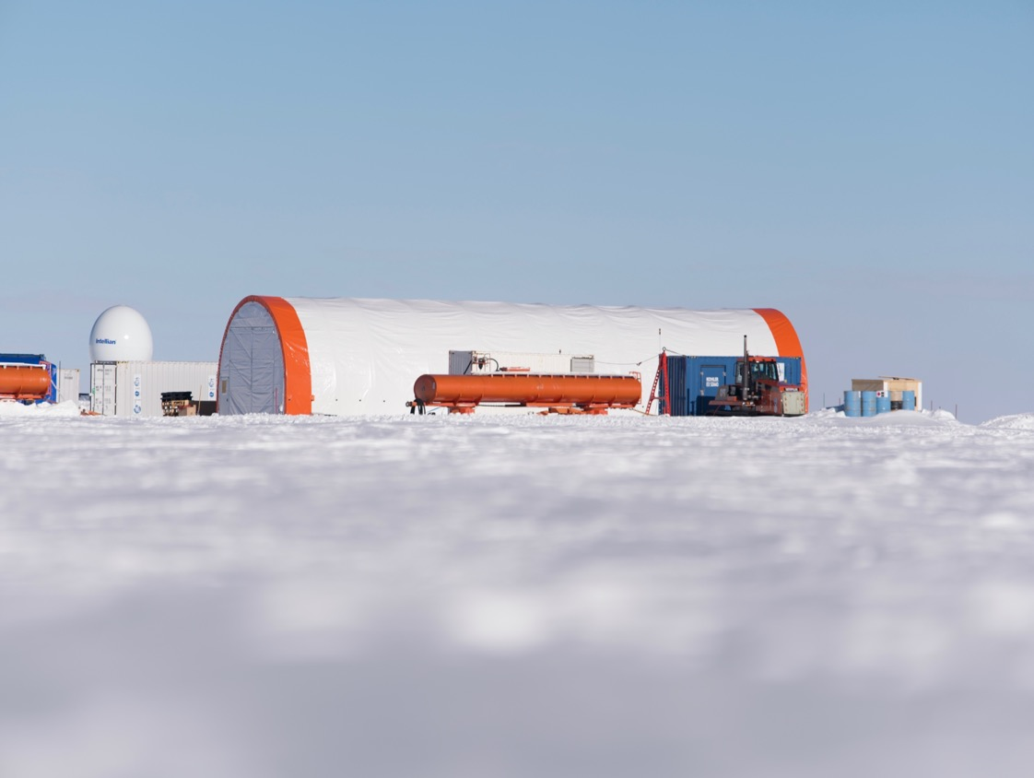
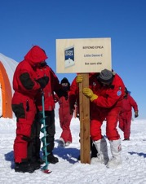
Beyond EPICA: Drilling Progress 2022/23 – 804.65 m
LDC first survey | LDC camp open date | Drillers on the field | LDC camp close | 6 pax to MZS | All the staff to MZS | Departure from MZS to McM | LDC time open (days)
15.11.2022 | 30.11.,2022 | 02.12.2022 | 21.01.2023 | 23.01.2023 | 26.01.2023 | 04.02.2023 | 52
Cutting plan for ice 0-1400 m
130.00 m 2021/22
804.65 m 2022/23
Brittle Ice
Total: 1.127 days
MZS TIME: 262 pax/day (23,25%)
DC/LDC TIME: 865 pax/day (76,75%)
ca 2.700 m

