Slide 1
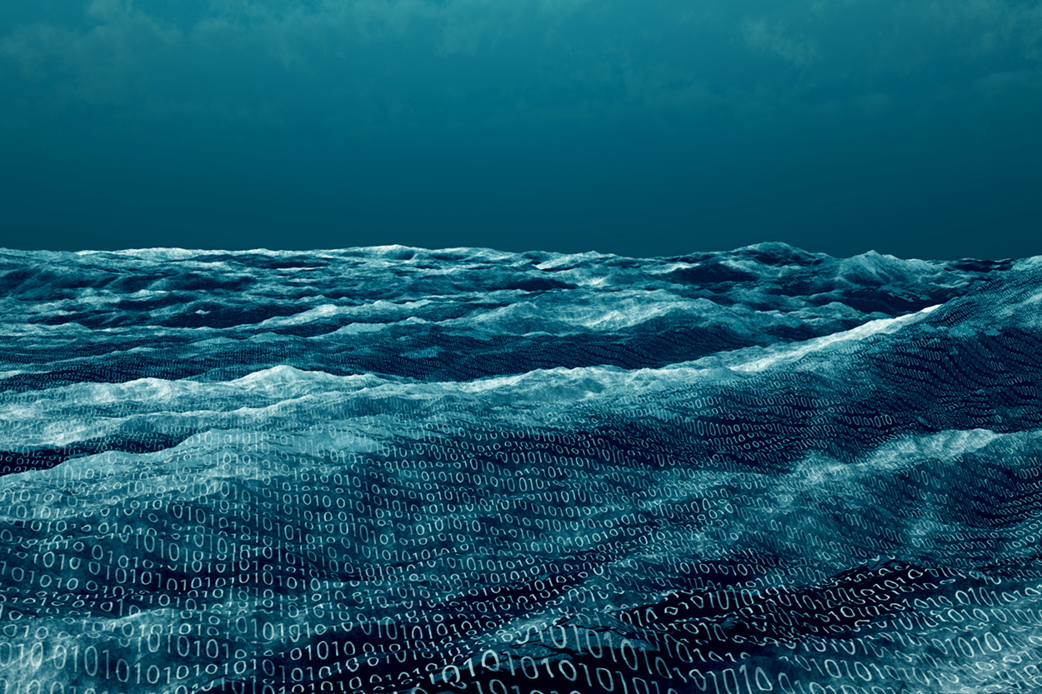


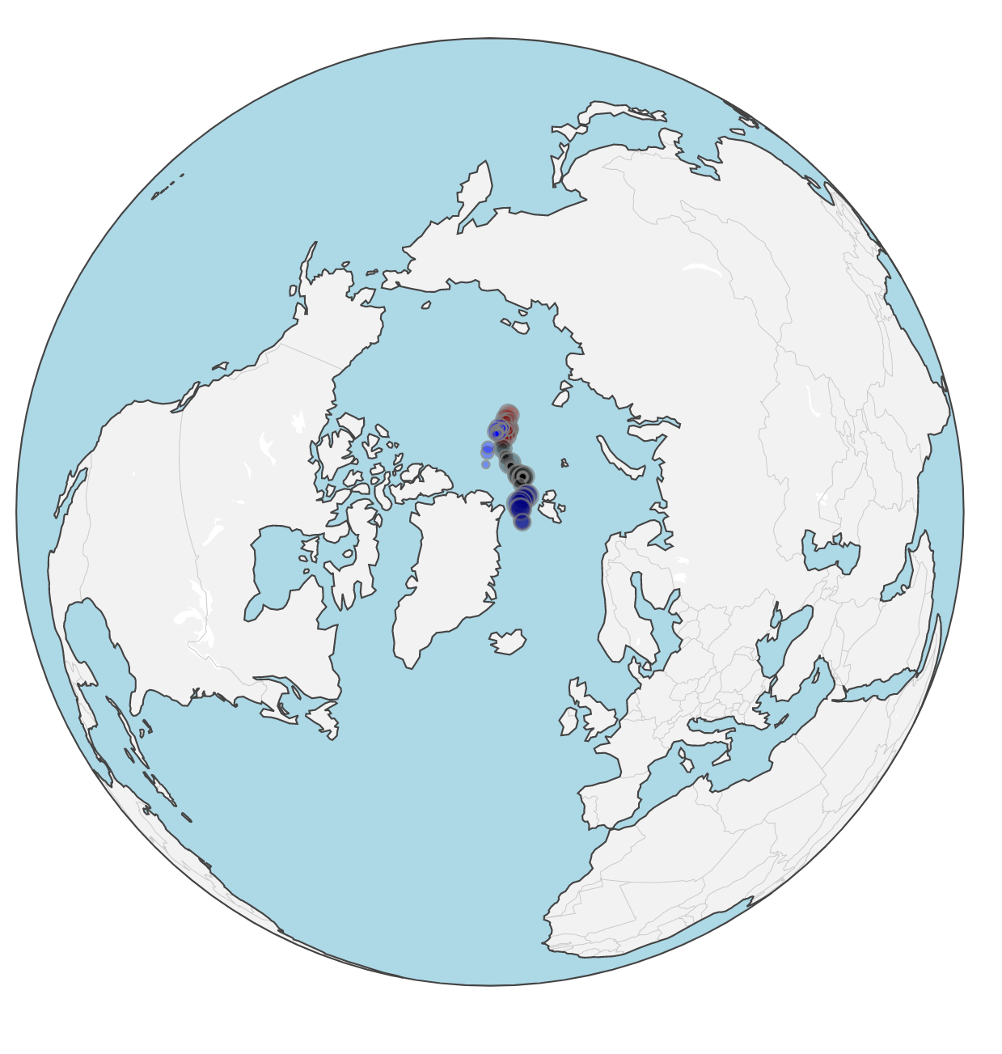
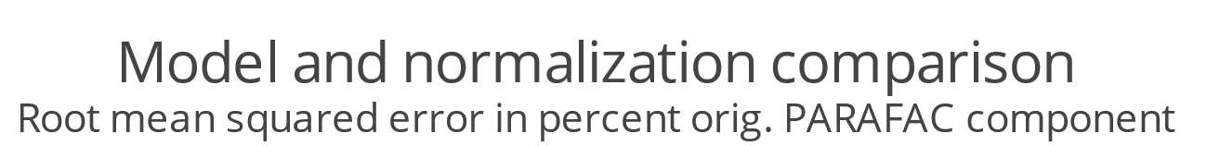
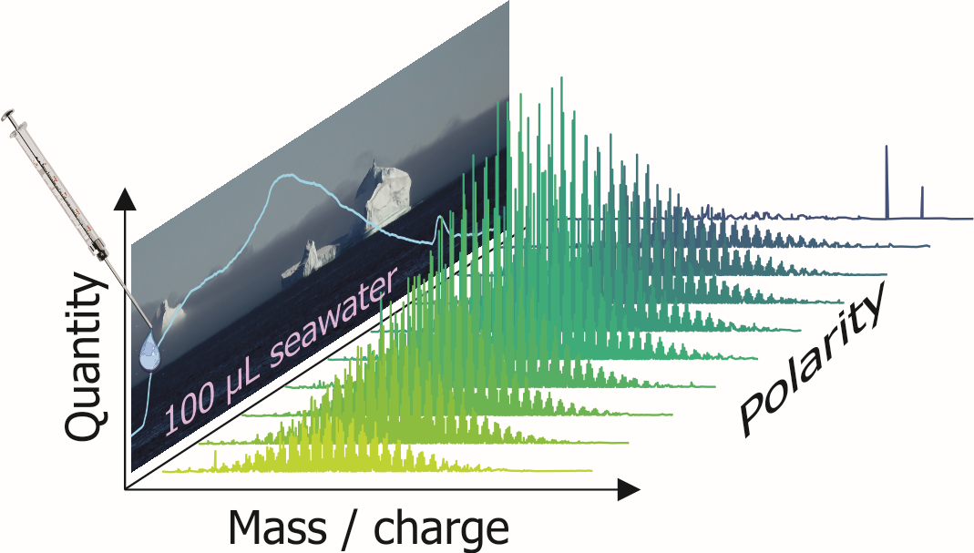
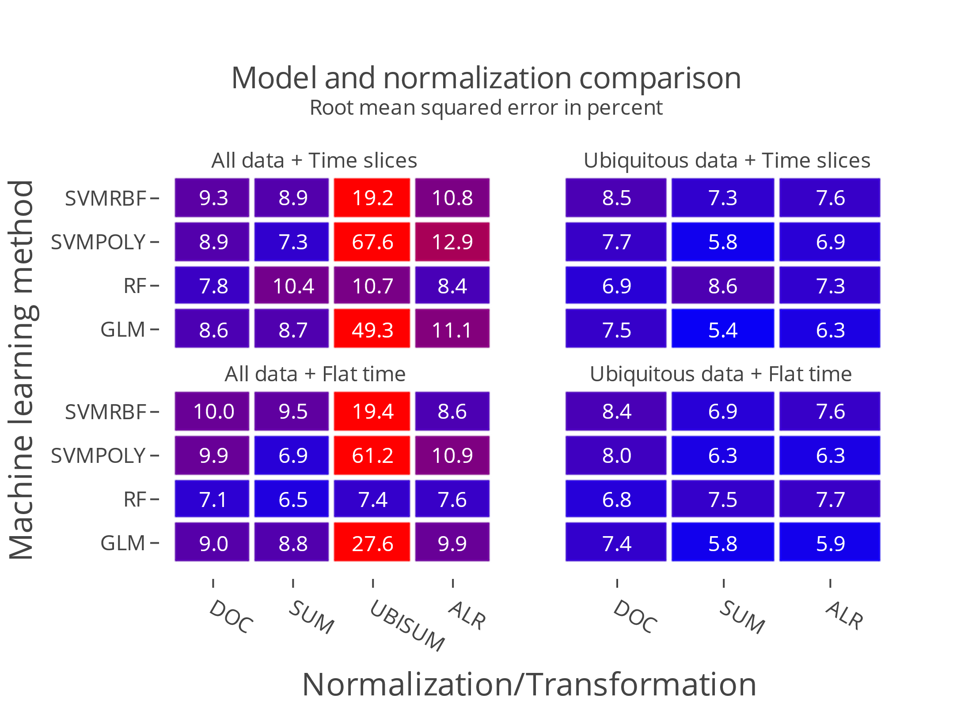
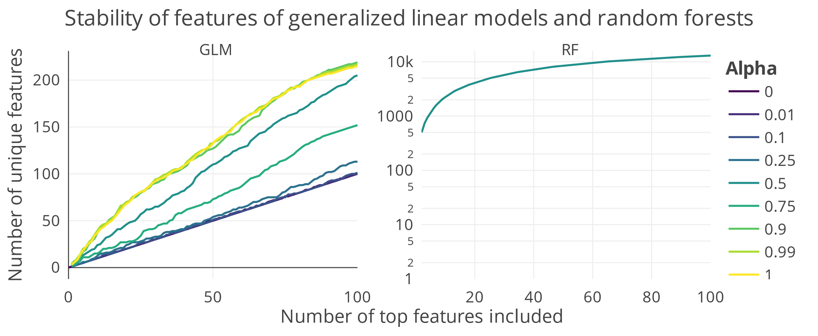
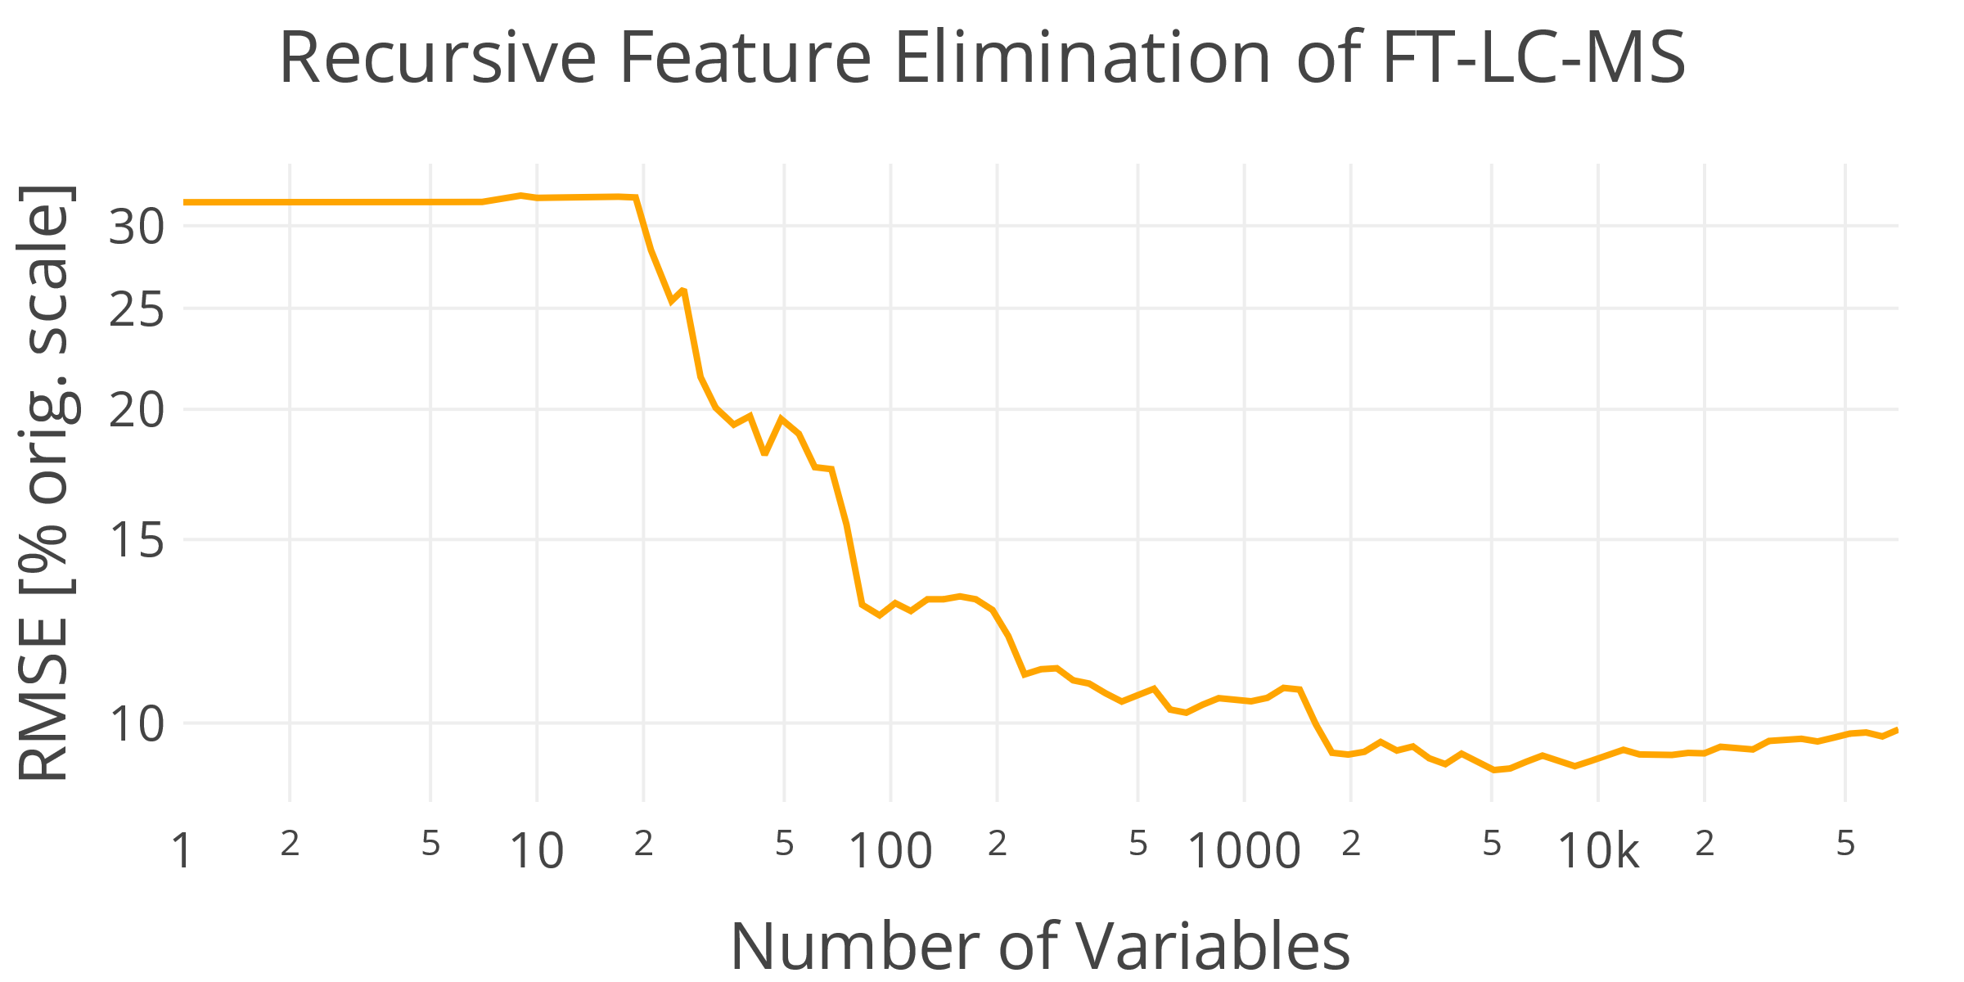
Analysis of key features in LC-FT-MS measurements of dissolved organic matter
Marlo Bareth^{1,3}, Boris P. Koch^{1,5}, Gabriel Zachmann³, Sebastian Maneth³, Christian L. Müller⁴, Oliver Lechtenfeld², Xianyu Kong¹
Mail: marlo.bareth@awi.de
¹ Alfred Wegener Institute for Polar and Marine Research, Germany
² UFZ-Helmholtz Centre for Environmental Research, Germany
³ University of Bremen, Germany
⁴ LMU Munich, Germany
⁵ Bremerhaven University of Applied Sciences, Germany
Introduction
Marine Dissolved Organic Matter (DOM) is one of the most complex mixtures on the planet¹
  Organic compounds in seawater that pass a filter
  Role in global carbon cycle only partially known
Liquid Chromatography Fourier-Transform Mass
Spectrometry (LC-FT-MS)
  “Fingerprint” of the molecular formulas (no structure)
Motivation
Can LC-FT-MS samples predict terrestrial proxies?
  E.g., fluorescence PARAFAC component^{2,3}
Can we identify key features that predict
terrestrial influence from arctic rivers^{4,5}?
How are machine learning models are affected by
normalization methods?
Fig. 1: Terrestrial influx from rivers in
Siberia and location of sampling points.⁴
MOSAiC expedition: 1-year Central Arctic drift study^{3,4}
LC-FT-MS peak list with intensities
Original seawater measurements¹
95 samples
10 scans per sample
  Separated by polarity
~70,000 total molecular
formula time points (MFTs)
  Each MFT is a feature
  E.g. C₂₀H₁₀O₆ at 17 minutes
Prediction/terr. proxy:
  Fluorescent DOM
  PARAFAC component^{2,3}
Data set
Results
C₁₀H₂₀O₆ at 17 min.
Fig. 2: Each sample contains the masses/molecular formulas split by their polarity. The FT-LC-MS measures how abundant each MFT is in the original seawater sample. The blue line shows the total ion count over time. Each peak is one feature for our methods. ¹
Fig. 3: Time slices: Inclusion of the time dimension, where a feature is a MFT. Flat time: Removed the retention time by combining the scans to one. Normalizations: Dividing by DOM- concentration contained (DOC), sum of all peak intensities (SUM), sum of all ubiquitous peaks (UBISUM), additive log ratio transformation based on the most stable ubiquitous feature (ALR). Except for ubiquitous sum normalization, the models perform similarly. Support Vector Machines (SVM), Random Forest Regression (RF), Generalized Linear Models (GLM). Ubiquitous data is better to predict the terrestrial proxy. UBISUM has high RMSEs, excluding RF. Flat time similar patterns to time slices. Best prediction by GLM, SUM normalization, ubiquitous data with time slices.
Fig. 4: GLMs provide more stable top important features than RFs. 1000 runs were used and the number of unique features in the top N positions counted. Average morula for GLM: C₁₉H₂₃O₁₀N. Avg. for RF: C₂₀H₂₇O₁₁N₂
Random forest (RF) as good general purpose tool
  Independent on normalization
  Ubiquitous sum performs well using RFs
Generalized linear models as in-depth tool
  Best prediction (SUM norm.)
  Stable important features
Only 3000 MFT features yield similar prediction
power as 70,000 (RFs)
Discussion
Fig. 5: Three thousand features have the same predictive power when recursively eliminating features using RF. Recalculation of the importance at every iteration. Ten fold cross validation was applied each step. Box shows the area without big increase of RMSE when removing features.
References
[1] Lechtenfeld, O.J., Kaesler, J., Jennings, E.K., Koch, B.P. (accepted). Direct analysis of marine dissolved organic matter using LC-FT-ICR MS. Environmental Science & Technology.
[2] Nebbioso, A., & Piccolo, A. (2013). Molecular characterization of dissolved organic matter (DOM): A critical review. In Analytical and Bioanalytical Chemistry (Vol. 405, Issue 1, pp. 109–124). Springer. https://doi.org/10.1007/s00216-012-6363-2
[3] Kong, Xianyu; Granskog, Mats A; Hoppe, Clara Jule Marie; Fong, Allison A; Stedmon, Colin A; Tippenhauer, Sandra; Ulfsbo, Adam; Vredenborg, Myriel; Hölemann, Jens A; Koch, Boris P (2022): The composition of chromophoric dissolved organic matter in Central Arctic surface waters during the MOSAiC expedition. PANGAEA, https://doi.org/10.1594/PANGAEA.948019
[4] Kong, X. (2022): Molecular and optical characterization of dissolved organic matter in the Central Arctic Ocean / B. Koch (editor) PhD thesis
[5] Raymond, P. A., and Spencer, R. G. M. (2015). Riverine DOM, in Biogeochemistry of Marine Dissolved Organic Matter (Elsevier), 509–533. doi: 10.1016/B978-0- 12-405940-5.00011-X

