Slide 1
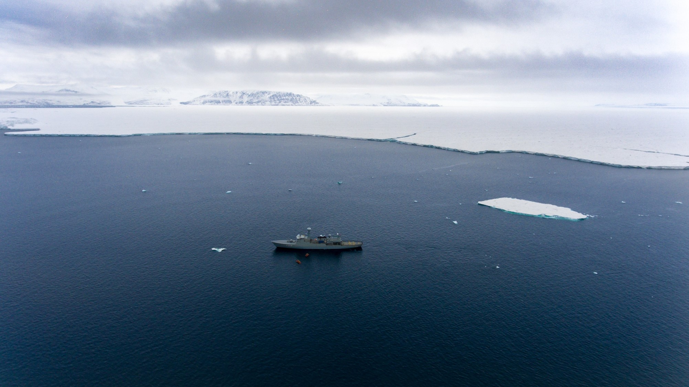
SPP 1889 conference
June 6, 2023
High-resolution simulation of the ocean circulation beneath the 79° North Glacier, Northeast Greenland
Claudia Wekerle, Sergey Danilov, Torsten Kanzow, Rebecca McPherson, Patrick Scholz, Ralph Timmermann and Qiang Wang

