Slide 1
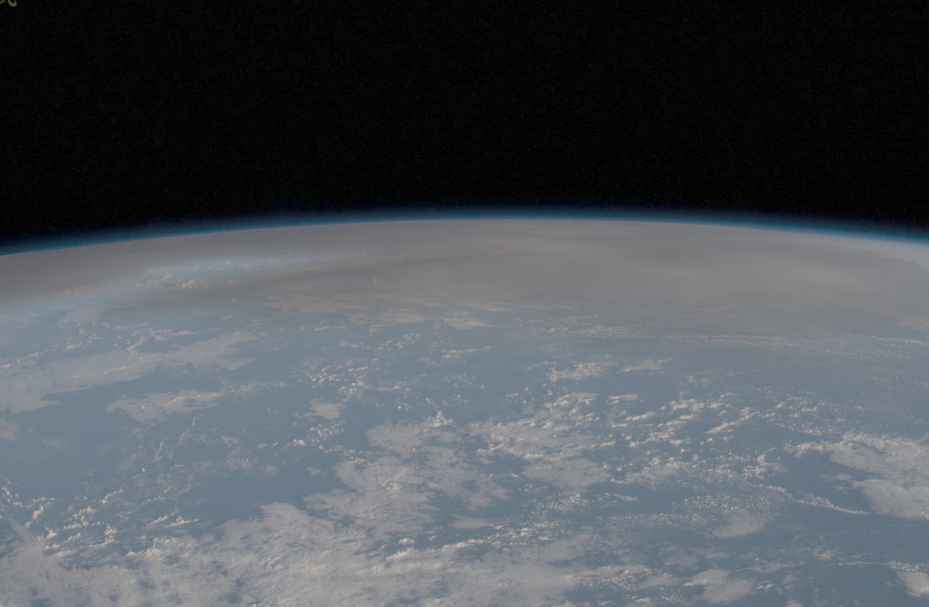
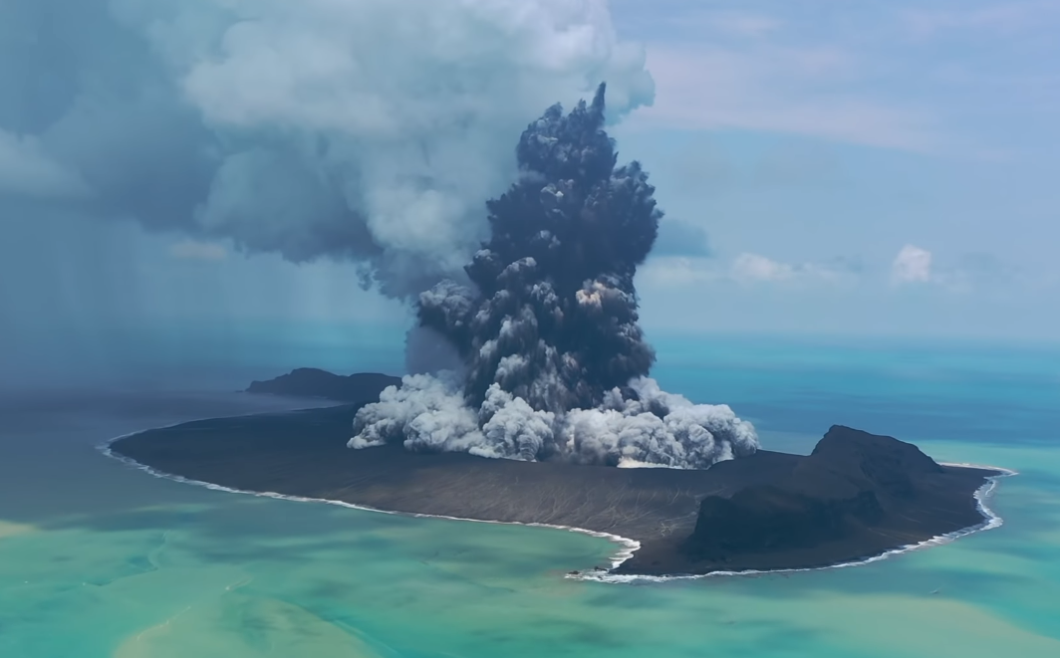
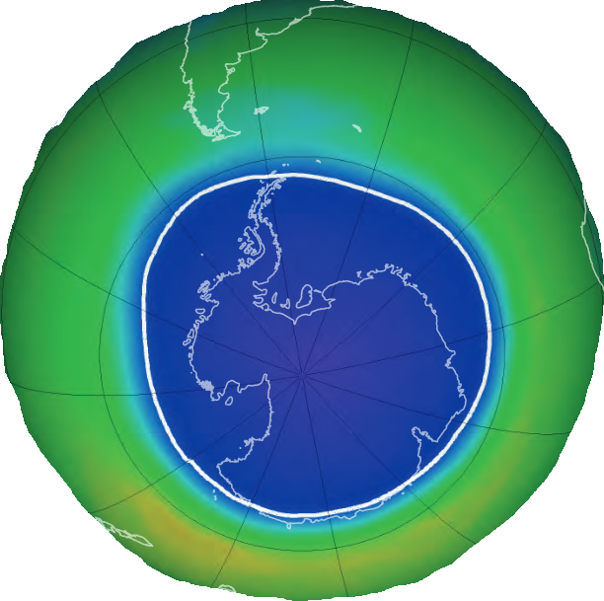
The chemical effect of increased water vapor from the Hunga Tonga-Hunga Ha’apai eruption on the Antarctic ozone hole
Ingo Wohltmann¹, Michelle Santee², Gloria Manney^{3,4}, Luis Millán²
1 Alfred Wegener Institute, Helmholtz Centre for Polar and Marine Research, Potsdam, Germany
2 Jet Propulsion Laboratory, California Institute of Technology, Pasadena, CA, USA
3 NorthWest Research Associates, Socorro, NM, USA
4 New Mexico Institute of Mining and Technology, Socorro, NM, USA

Slide 2
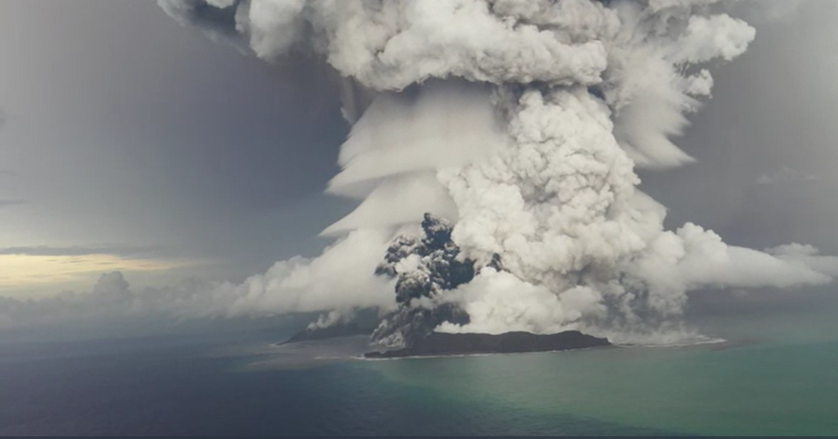
Introduction
Eruption of the Hunga Tonga-Hunga Ha’apai volcano on 15 January 2022 among the most explosive eruptions of the last decades
Amount of sulfur injected into stratosphere unremarkable (~0.5 Tg, compare Pinatubo ~30x larger)
Amount of water vapor injected unprecedented in the observational record (~150 Tg)
Global stratospheric water vapor burden increased by ~10%
What is the effect of the increased water vapor on the ozone hole?
Wikimedia Commons

Slide 3
Introduction
In 2022, increased water vapor from HT was not able to penetrate Antarctic vortex
It was speculated that increased water vapor could lead to increased ozone depletion in 2023
Water vapor can influence polar ozone depletion mainly by its effect on polar stratospheric clouds (PSCs):
Changes in formation temperature thresholds
Particle size distribution
Dehydration
Denitrification
Wikimedia Commons

Slide 4
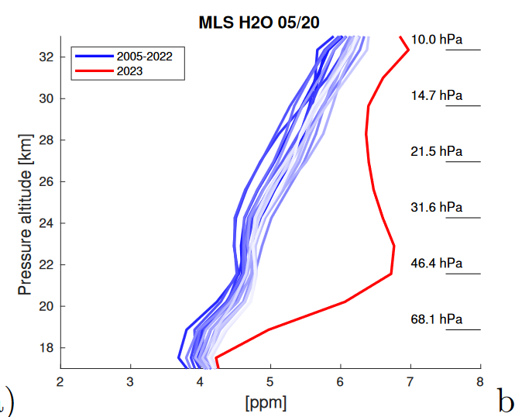
Observations
Vortex average
Water vapor observed by MLS in the developing Antarctic vortex (20 May) in 2023 increased by about 20% to 40% compared to all earlier years in MLS record (2005-2022)

Slide 5
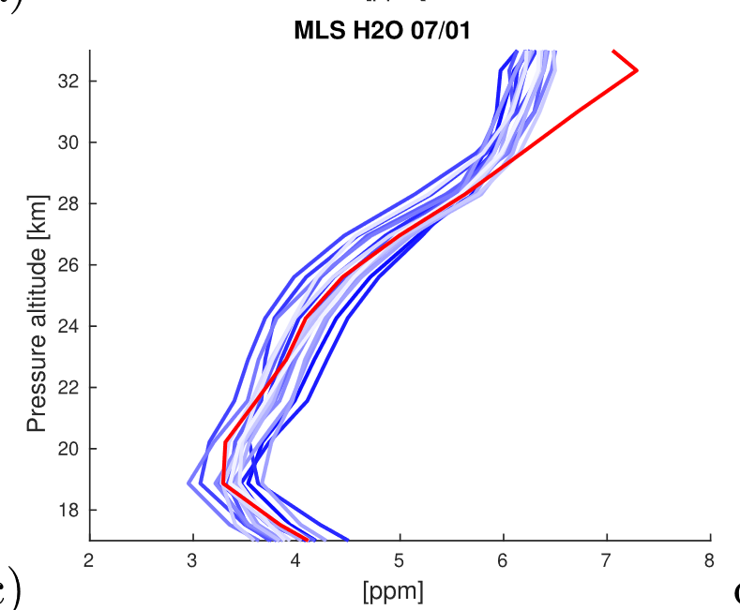
Observations
Vortex average
Observed water vapor in 2023 was back to the range
of earlier years in July

Slide 6
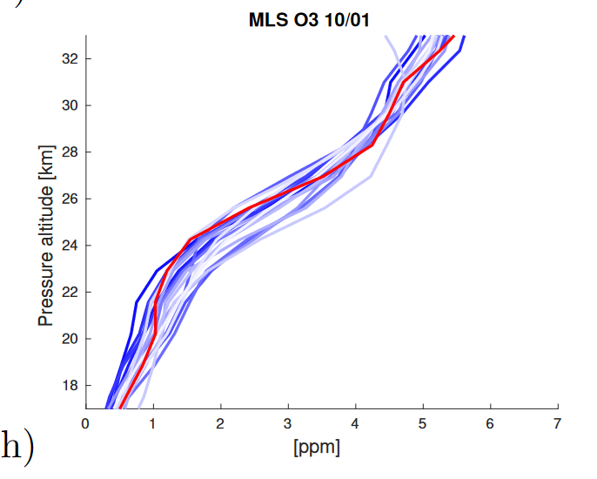
Observations
Vortex average
Ozone in 2023 was in the range of earlier years from May to October
Left: Ozone after the end of the most severe ozone loss period (1 October)

Slide 7
Model
It is not possible to disentangle the PSC effect of water vapor on ozone loss from other effects (temperatures etc.) only with observations
ATLAS Chemistry and Transport Model
Model resolution 150 km
Driven by ECMWF ERA5 reanalysis
Comprehensive chemistry and PSC scheme (NAT, STS, ice)
Dehydration by simple scheme that removes all water vapor above a supersaturation of 0.7
Denitrification by DLAPSE scheme (nucleation, growth, sedimentation, and evaporation of individual particles)
Runs
Reference run: Initialized with MLS data from 1 May 2023
Sensitivity run without the effect of Hunga Tonga on water vapor: Uses exactly the same setup, with the exception of the initialization of MLS water vapor, which is taken from the preceding year on 1 May 2022

Slide 8
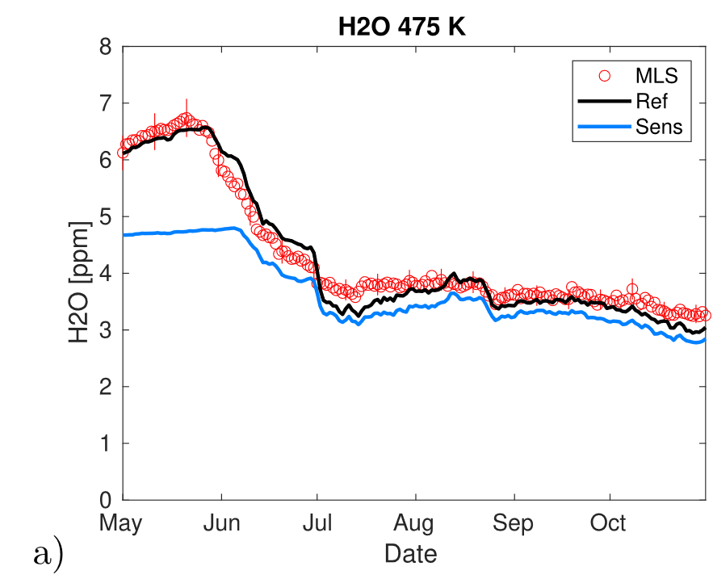
Model
Vortex average
Water vapor in reference run and MLS agree well
Sensitivity run does not agree with MLS in May/June (as expected), but approaches reference and MLS starting in July
Water vapor is limited to the saturation pressure due to the low temperatures in the vortex
This resets any anomalies through dehydration

Slide 9
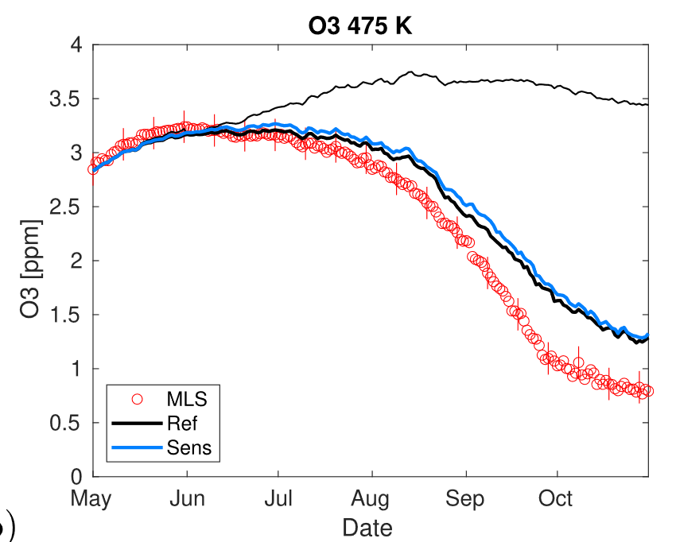
Model
Vortex average
Thin line: Passive ozone tracer (initialized 1 June). Difference to this line is ozone loss
Ozone and ozone loss agree well in reference and sensitivity run
Dehydration resets water vapor anomalies before they can affect ozone loss
Model underestimates MLS ozone loss by about 30% (in contrast to good agreement with observations for other winters)

Slide 10
Conclusions (I)
Water vapor
The Hunga Tonga-Hunga Ha’apai eruption increased water vapor in the emerging Antarctic vortex in 2023 by 20–40% compared to earlier years
Observed water vapor in 2023 was back to the range of earlier years in July
Ozone and temperature
Ozone in 2023 was in the range of earlier years from May to October
Vortex temperatures in 2023 were close to the long-term mean and not exceptionally low (not shown)

Slide 11
Conclusions (II)
Ozone loss and dehydration
The increased water vapor from Hunga Tonga had a minor effect on Antarctic ozone depletion through the end of October in ATLAS (less than 4 DU)
This minor effect is due to the low temperatures in the vortex, as they occur every year in the Antarctic. This limits water vapor to the saturation pressure and resets any anomalies through dehydration before they can affect ozone loss
ATLAS runs underestimate observed ozone loss in 2023 by about 30% (in contrast to good agreement with observations for other winters). Some processes not captured by ATLAS are: HTHH water vapor radiative effects in ERA5 and changes in aerosols.
MLS ClO mixing ratios typically align within 10% margin with ClO mixing ratios modeled by ATLAS, suggesting that the discrepancy is not caused by an underestimation of chlorine activation (not shown)
Wohltmann et al., 2024,
Geophys. Res. Lett.,
doi:10.1029/2023GL106980

Slide 12
Additional slides

Slide 13
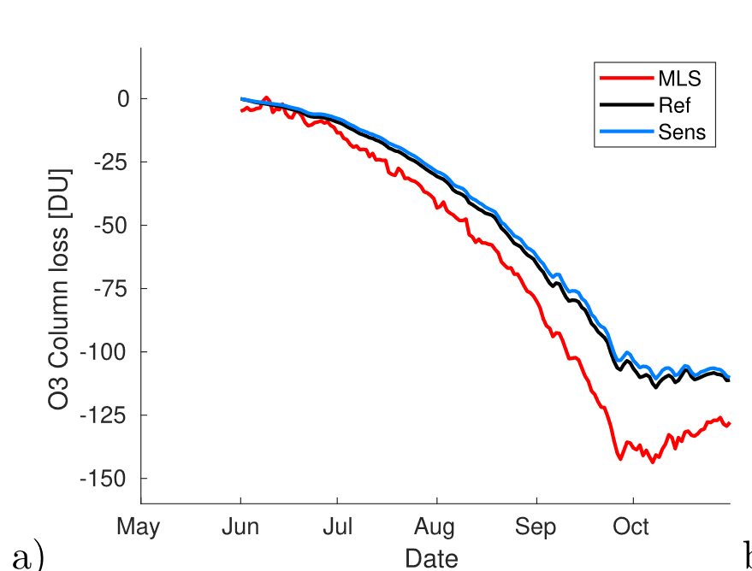

Slide 14
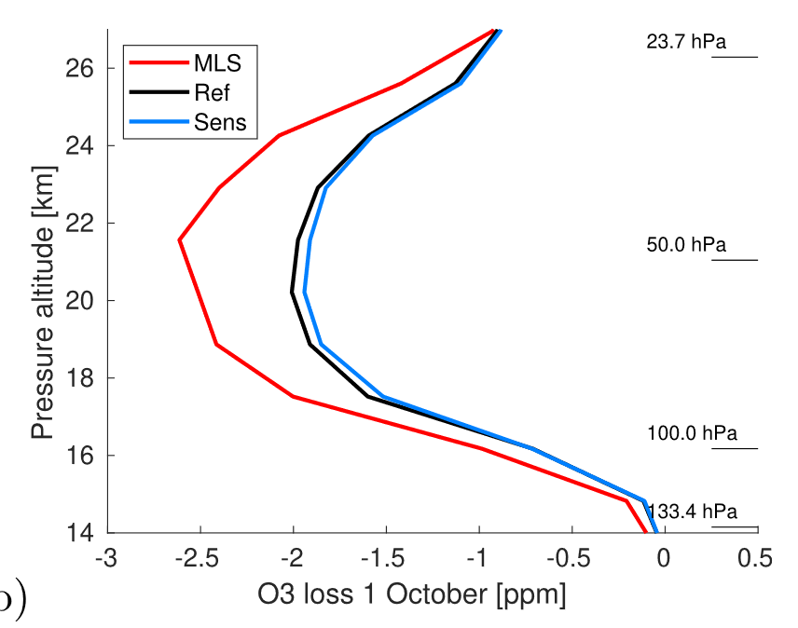

Slide 15
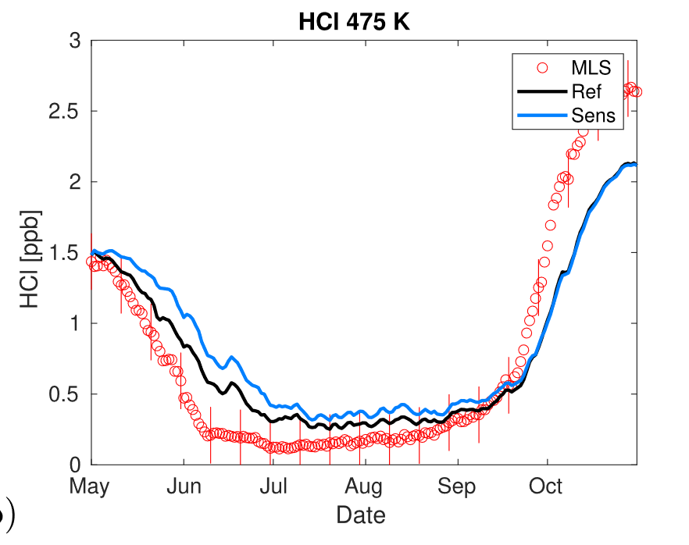

Slide 16
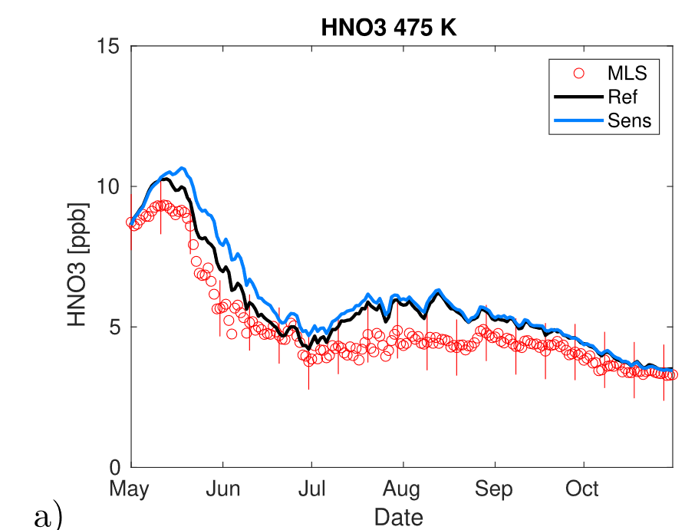

Slide 17
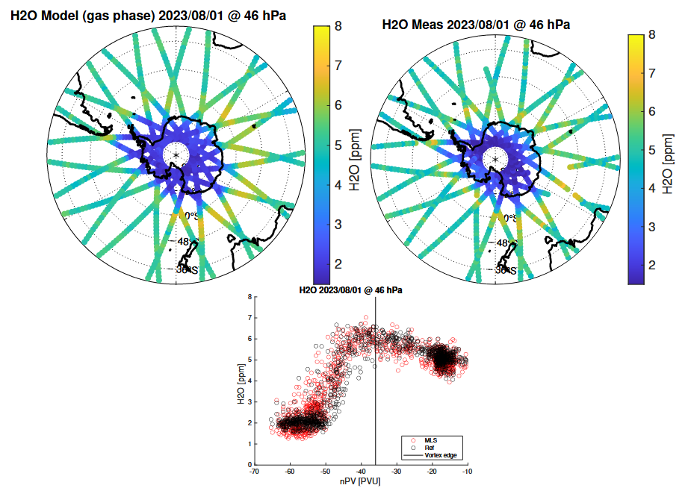

Slide 18
