Slide 1
Motivation
Fast ozone chemistry for climate models
Ozone often prescribed in climate models, since detailed calculation computationally very expensive
e.g. in IPCC CMIP5 models (IPCC, 2013, section 9.1.3.2.6)
Desirable to include interactive ozone in climate models due to importance of ozone-climate interactions
e.g. Effect of changes in polar stratospheric vortex and ozone on surface temperature trends in Antarctica (Thompson and Solomon, Science, 296, 895-899, 2002)
e.g. Effect of ozone on climate change
(Nowack et al., Nature Clim. Change, 5, 41-45, 2015)

Slide 2
Papers
Polar SWIFT
Wohltmann et al., Update of the Polar SWIFT model for polar stratospheric ozone loss, Geosci. Model Dev., 10, 2671-2689, 2017
Wohltmann et al., A quantitative analysis of the reactions involved in stratospheric ozone depletion in the polar vortex core, Atmos. Chem. Phys., 17, 10535-10563, 2017
Extrapolar SWIFT
Kreyling et al., The Extrapolar SWIFT model (version 1.0): fast stratospheric ozone chemistry for global climate models, Geosci. Model Dev., 11, 753-769, 2018

Slide 3
Polar SWIFT

Slide 4
Polar SWIFT: Overview
Fast model for vortex averaged polar ozone loss
Only 4 prognostic equations per altitude (vortex average)
Large time step possible (1 day)
Solves system of coupled differential equations for key species:
HNO₃ (total)
HNO₃ (gas phase)
HCl
ClONO₂
ClO_{x}
O₃

Slide 5
Polar SWIFT: Overview
Includes terms for the overall net effect of chemical mechanisms and not for every single reaction
Equations are based on our physical understanding of the system and the relevance of effects
Example: Equation for ozone change is (put simply):
“Ozone change”=“Amount of active chlorine” * “Amount of sunlight”
Difference to existing Taylor series based fast (extrapolar) ozone schemes (e.g. Cariolle scheme, Linoz scheme):
Based on physical understanding
Can cope with the nonlinear effects of polar ozone chemistry
Works well in changing conditions due to climate change or changing CFCs

Slide 6
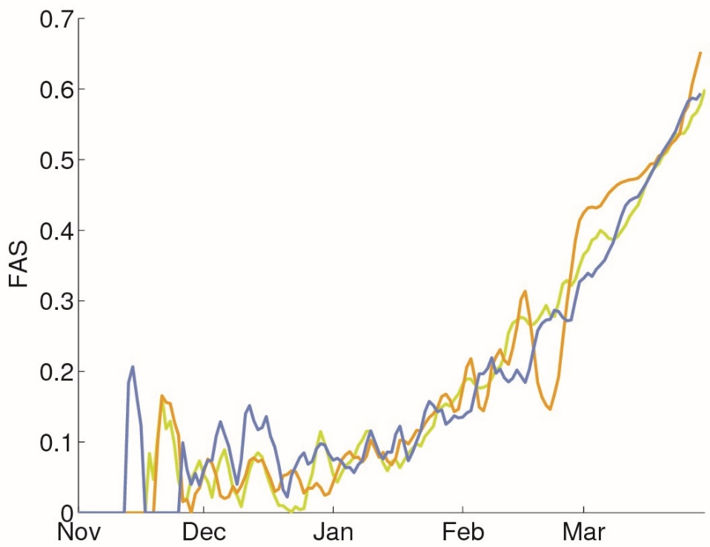
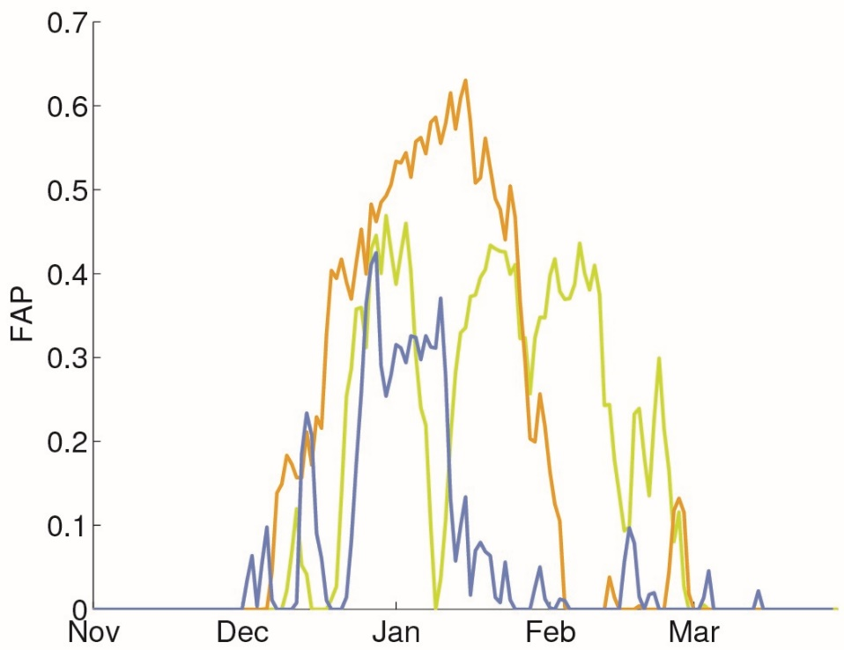
Input needed from the GCM
Only 2 external parameters drive the model:
Fraction of polar vortex exposed to sunlight (FAS)
Fraction of polar vortex below the threshold temperature for PSC formation (FAP)
Parameters needed from the GCM: Temperature field, PV field, solar zenith angle
(colors: different example years)

Slide 7
Polar SWIFT: Equations
Species concentrations: Vortex averages. a…z: Empirical parameters trained on ATLAS data.
Prognostic
d[O₃]/dt=-d[ClO_{x}]FAS Ozone depletion by ClO+ClO and ClO+BrO cycle
d[ClONO₂]/dt=b[ClO_{x}][HNO₃gas]FAS Net effect of ClONO₂ photolysis / ClO+NO₂
-a[HCl][ClONO₂][HNO₃total]^{2/3}FAP Chlorine activation by HCl+ClONO₂ (heterogeneous)
-h[ClONO₂][HNO₃total]^{2/3}FAP Chlorine activation by ClONO₂+H₂O (heterogeneous)
d[HCl]/dt=c₁[ClO_{x}]FAS²/[O₃]+c₂[ClONO₂]FAS³/[O₃] Chlorine deactivation by Cl+CH₄ into HCl (SH)
+f[ClO_{x}]FAS² HCl formation by ClO+OH
-a[HCl][ClONO₂][HNO₃total]^{2/3}FAP Chlorine activation by HCl+ClONO₂ (heterogeneous)
-l[ClO_{x}]FAS[HCl][HNO₃total]^{2/3}FAP Chlorine activation by HOCl+HCl (heterogeneous)
-k[HCl]FAS² Activation by HCl+OH (gas phase)
d[HNO₃total]/dt=-e[HNO₃total]FAP_{s} Effect of denitrification
Diagnostic
[ClO_{x}]=[Cl_{y}]-[HCl]-[ClONO₂] ClO_{x} is everything not in reservoir gases
[HNO₃gas]=[HNO₃total](1-FAP_{s})+z[HNO₃total]FAP_{s} Partitioning HNO₃ (gas / clouds)

Slide 8
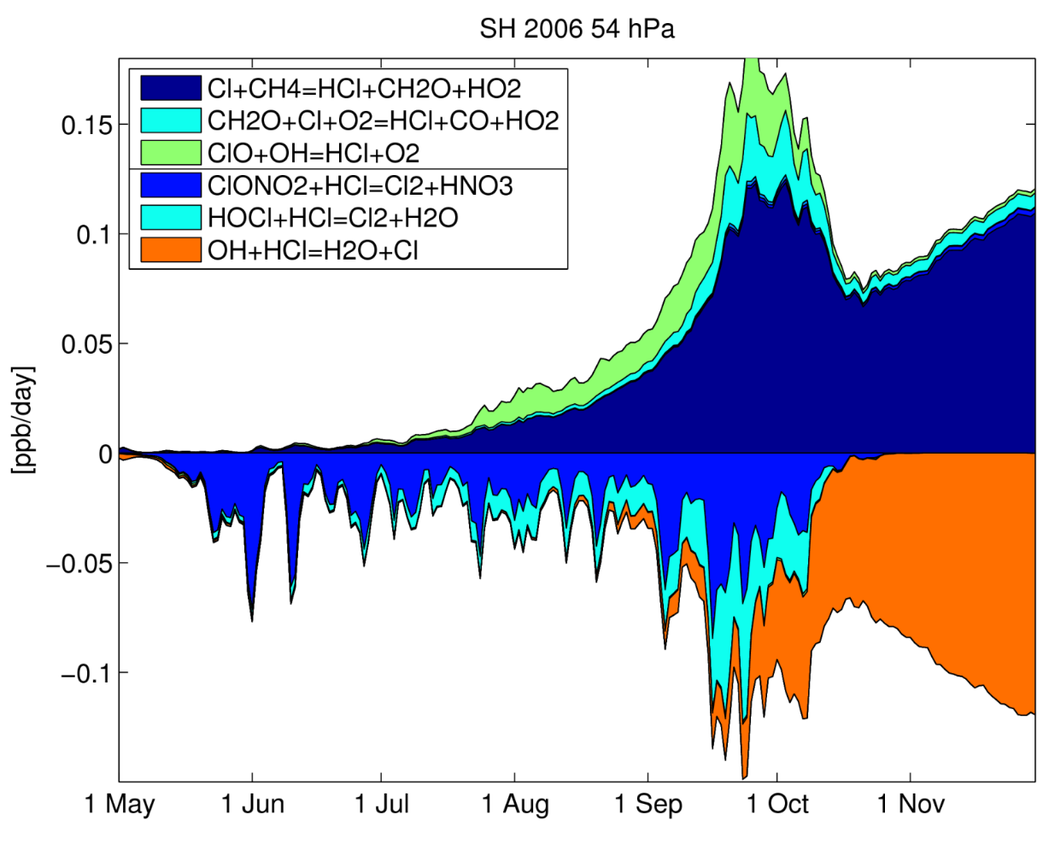
Training of the model
Proportionality constants of the individual terms are empirically fitted parameters trained on chemical reaction rates from the ATLAS Chemistry Transport Model
Trained on two Arctic and two Antarctic winters
Example:
Vortex averaged chemical reaction rates from the ATLAS model for HCl (SH 2006)

Slide 9
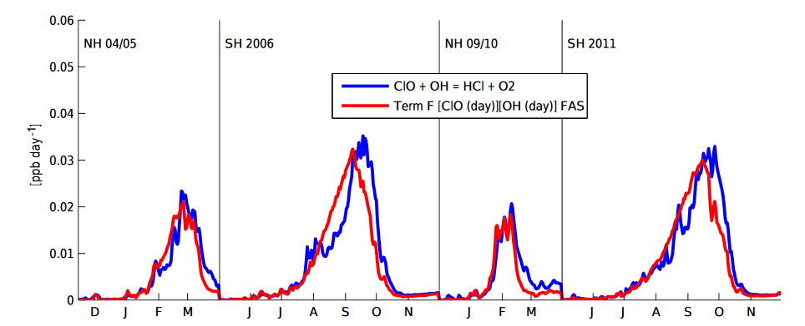
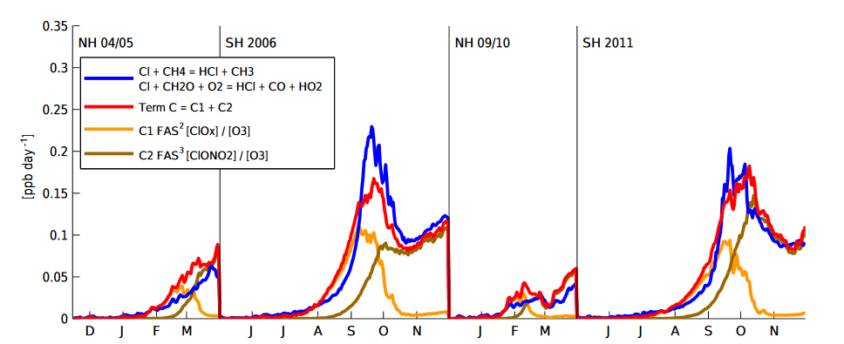
Training of the model
Two examples for HCl
Term for ClO+OH=HCl+O2
ATLAS CTM
Fit of SWIFT term
Term for Cl+CH4=HCl+CH3
(Chlorine deactivation SH)

Slide 10
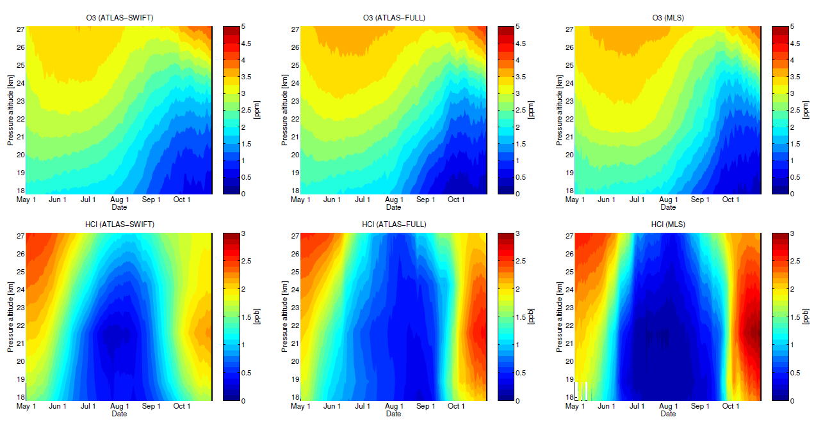
Validation: Polar SWIFT as chemistry module in ATLAS CTM
Driven by ECMWF ERA Interim, Winter SH 2006 vortex means
27 km
5
O3
ppm
Numerical Effort
Full chemistry model ATLAS-SWIFT polar
2 weeks/model year seconds/model year
48 processors 1 processor
18 km
0
27 km
3
HCl
ppb
18 km
0
May
Nov
May
Nov
May
Nov
ATLAS with SWIFT
ATLAS with full chemistry
MLS satellite

Slide 11
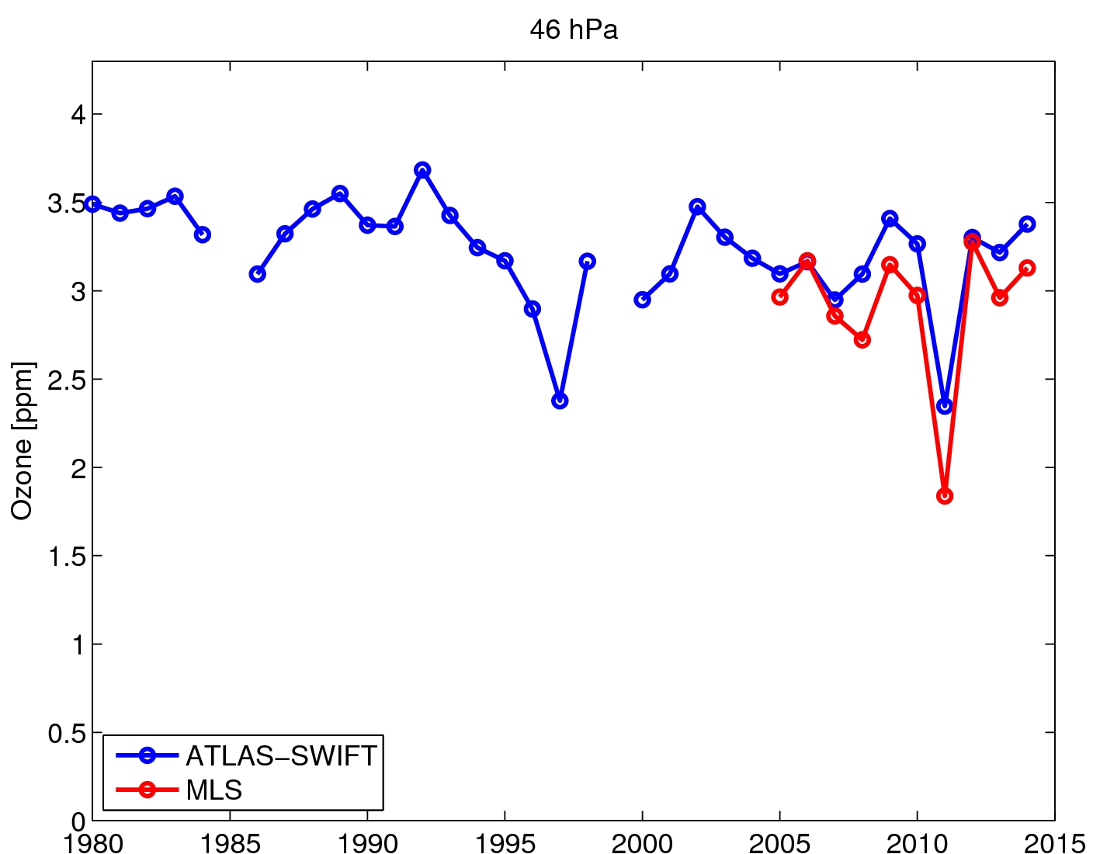
Interannual variability NH
Vortex averaged ozone shortly before vortex breakup at 46 hPa from SWIFT in ATLAS CTM

Slide 12
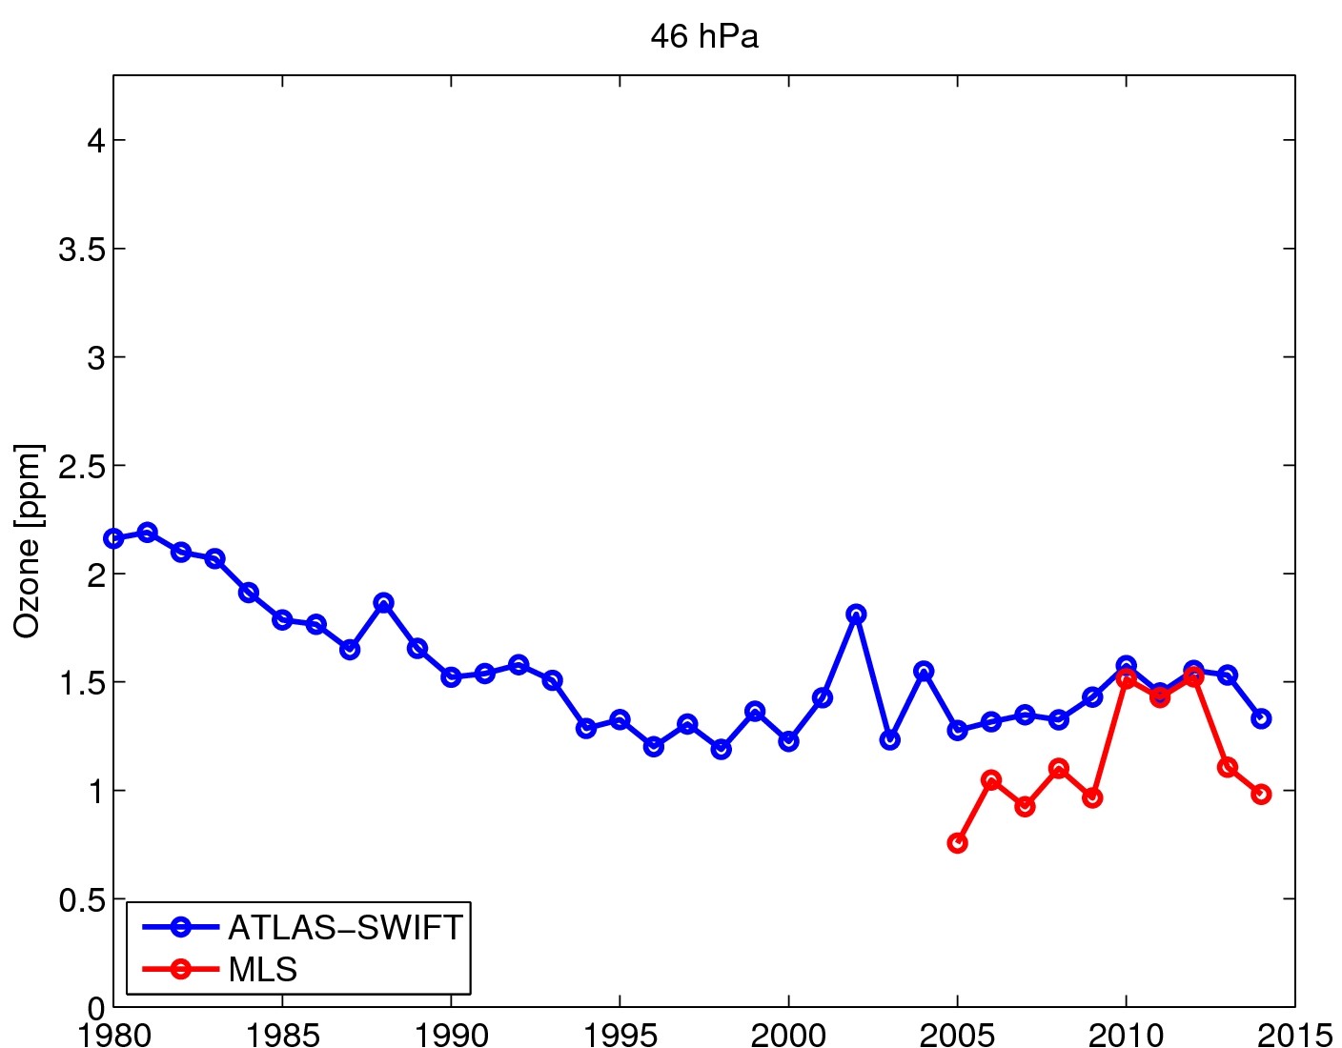
Interannual variability SH
Vortex averaged ozone 1 October at 46 hPa from SWIFT in ATLAS CTM

