Slide 1








Winter Arctic sea ice bottom evolution detected by thermistor
string-based ice mass balance buoys (SIMBA)
Bin Cheng¹, Timo Vihma¹, Yubing Cheng^{1,7}, Zeling Liao², Ruibo Lei³, Mario Hoppmann⁴, Yubao Qiu⁵,
Amy Solomon⁸, Roberta Pirazzini¹ and Stein Sandven⁶
¹Finnish Meteorological Institute, Meteorological Unit, Helsinki, Finland (bin.cheng@fmi.fi)
²School of Data and Computer Science, Sun Yat-sen University, GangZhou, China
³Polar Research Institute of China (PRIC), Shanghai, China
⁴Alfred Wegener Institute (AWI), Bremerhaven, Germany
⁵Institute of Remote Sensing and Digital Earth (RADI), Chinese Academy of Sciences (CAS), Beijing, China
⁶Nansen Environmental and Remote Sensing Center (NERSC), Thormoehlensgate 47, 5006 Bergen, Norway
⁷Institute of Atmospheric Physics, Chinese Academy of Sciences, China
⁸ Physical Sciences Laboratory, NOAA , USA
Objectives
Long term sustainable real time monitoring snow and ice mass balance and air-snow-ice-ocean temperature variations in the Arctic Ocean using sea ice mass balance buoy (SIMBA).
Develop a reliable algorithm to retrieve snow depth and ice thickness from SIMBA data.
Investigate thermodynamic snow and sea ice mass balance in the Arctic Ocean.
Notes:
This presentation demonstrate the deployment of thermistor string-based ice mass balance buoys (SIMBA) in the Arctic Ocean since summer 2018. We present how SIMBA data has been processed and some preliminary results on ice mass balance at bottom.

Slide 2

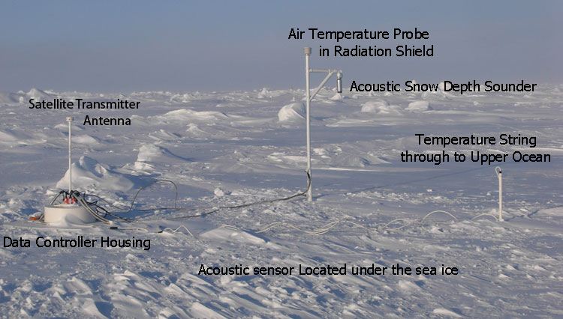
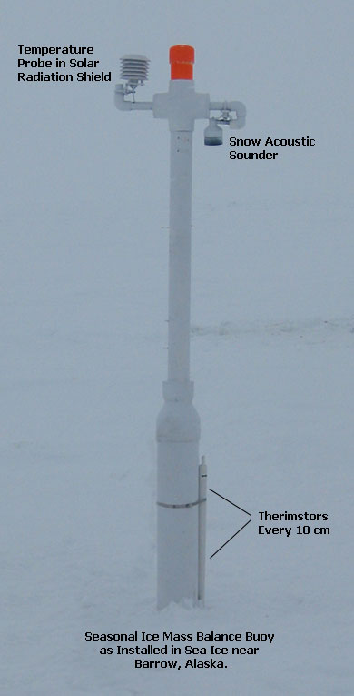
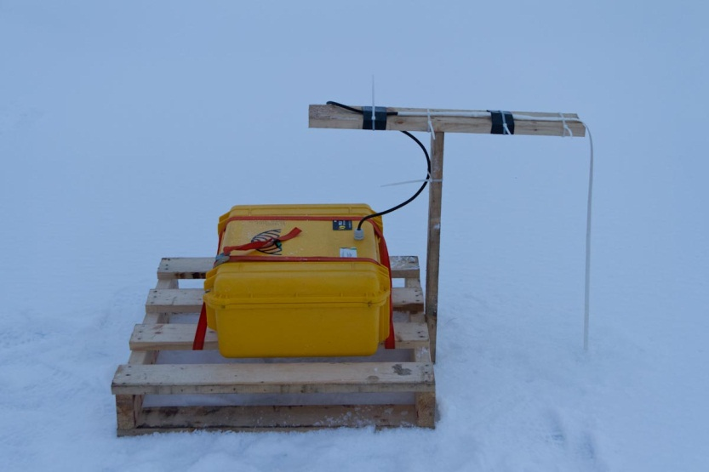


There are several type of IMBs with different technology configurations
We use the simplest one (SIMBA)
CRREL_IMB
CRREL-SIMB3
SIMBA
Notes:
We are aiming a SIMBA observation network, so cost-cutting is crucial.

Slide 3



SIMBA Environmental vertical temperature: ET-field
Air
< 0.4 m
Snow
< 0.8 m
< 3.0 m
Ice
< 1.0 m
Water
Air-Snow-Ice-Water (ASIW) system and temperature distribution vertically through ASIW in cold condition.
Notes:
SIMBA mainly observes temperature profile through air-snow-ice-ocean. The SIMBA thermistor string has 240 sensors and sensor interval is 2 cm.

Slide 4
SIMBA Heating temperature field (HT-field)
t0
t1
t2
Air
T1=T1-T0
T2=T2-T0
Snow
T0
T1
T2
Sea ice
Ocean
Time(t)
Schematically illustration on now the SIMBA heating works: a small identical heating element is applied on each sensor. The heating is done once per day. The heating interval usually lasts for 60 s and 120 s.
Notes:
In addition, SIMBA measures the heating temperature (SIMBA-HT) applying a small identical heating element on each sensor. The heating is applied once per day. The heating interval usually lasts for 60 s or 120 s. The temperature changes in air, snow, ice and water are different due to the different heat conductivities.

Slide 5
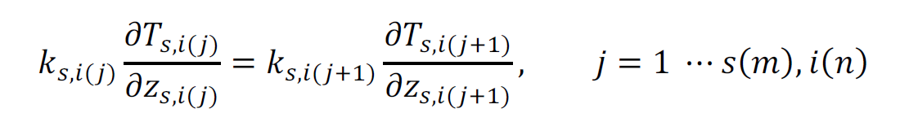
Δzs,i(j) = 2 cm
Liao et al., 2018, IJDE https://doi.org/10.1080/17538947.2018.1545877
Notes:
A SIMBA-algorithm was developed by Liao and others (2018) and used to extract snow depth and ice thickness from SIMBA-ET data. The algorithm was targeted for SIMBA data obtained from the Arctic Ocean, where the snow/ice interface remained unchanged.

Slide 6
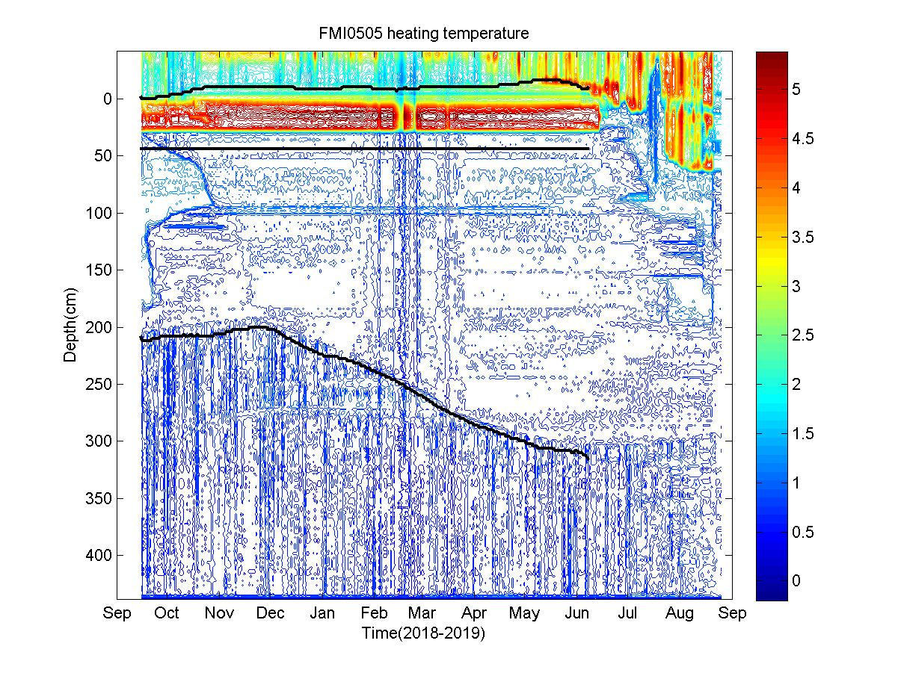
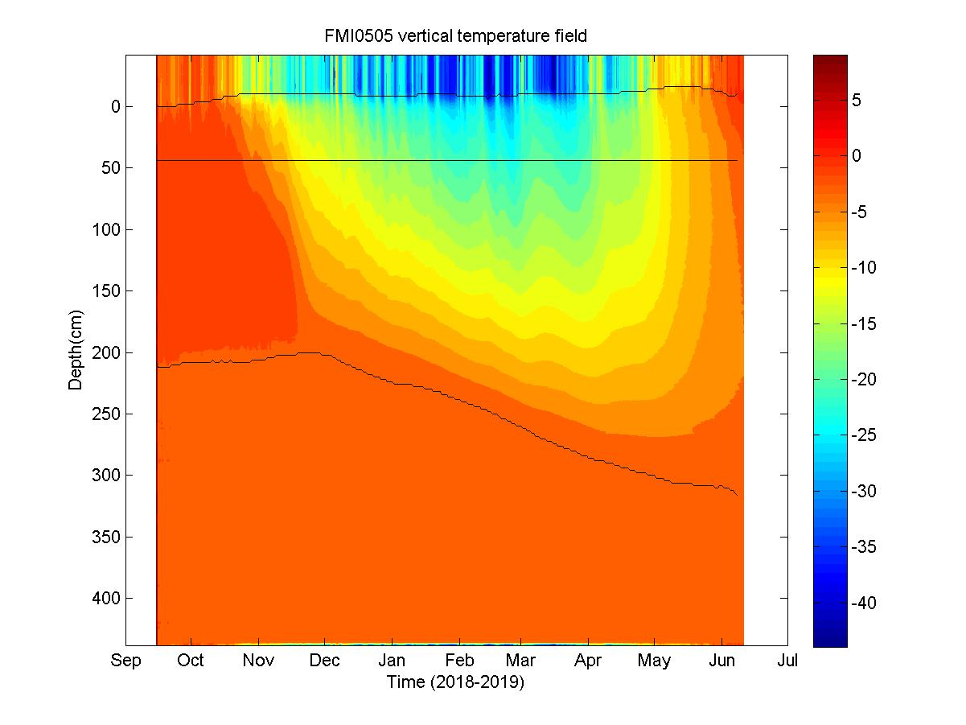
SIMBA- ET and SIMBA-HT field and algorithm (Liao et al, 2018) derived interfaces:
snow surface; sea level and ice bottom
Notes:
How the SIMBA algorithm results look like.

Slide 7
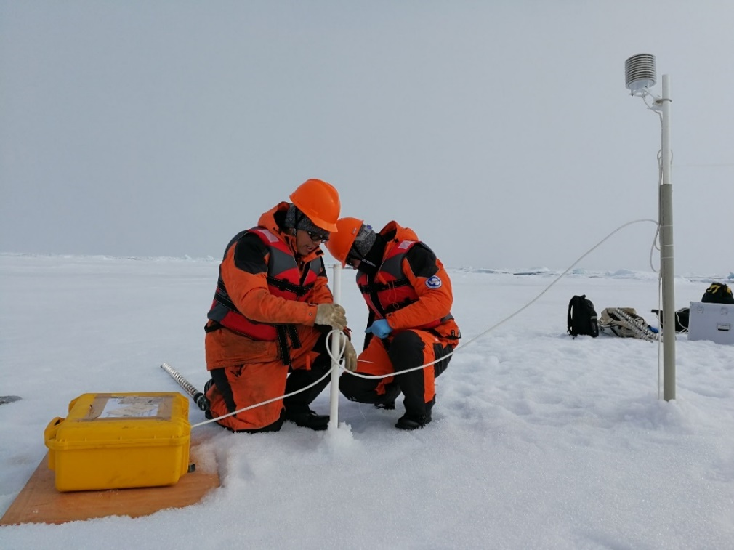
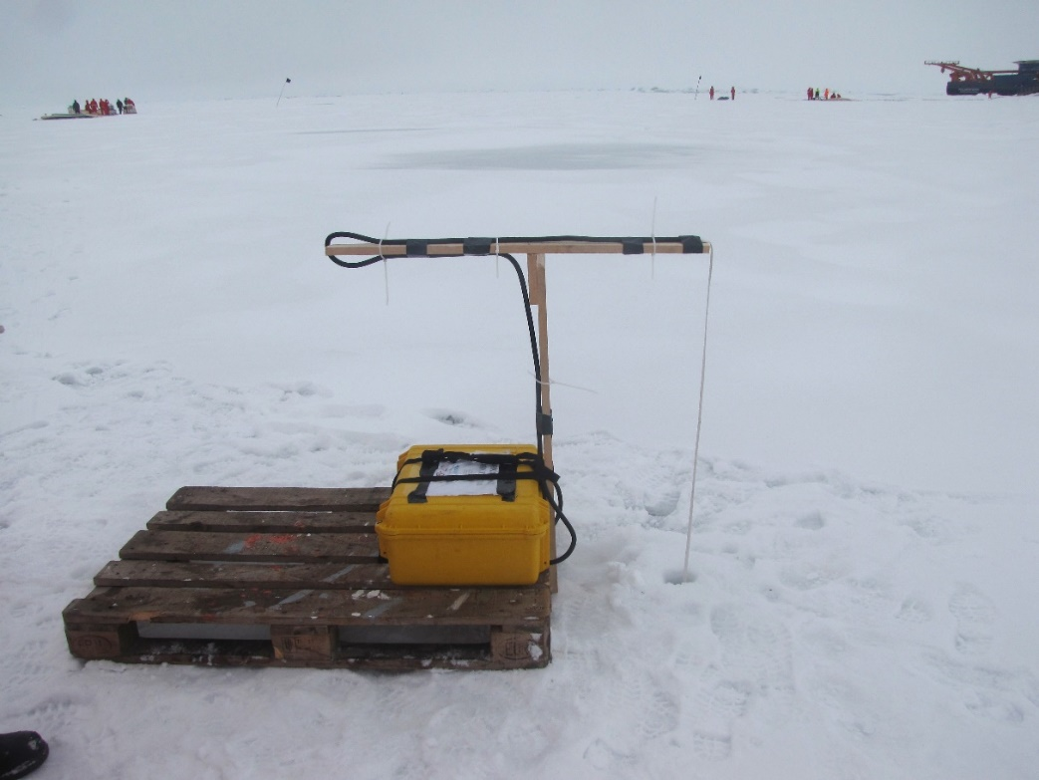
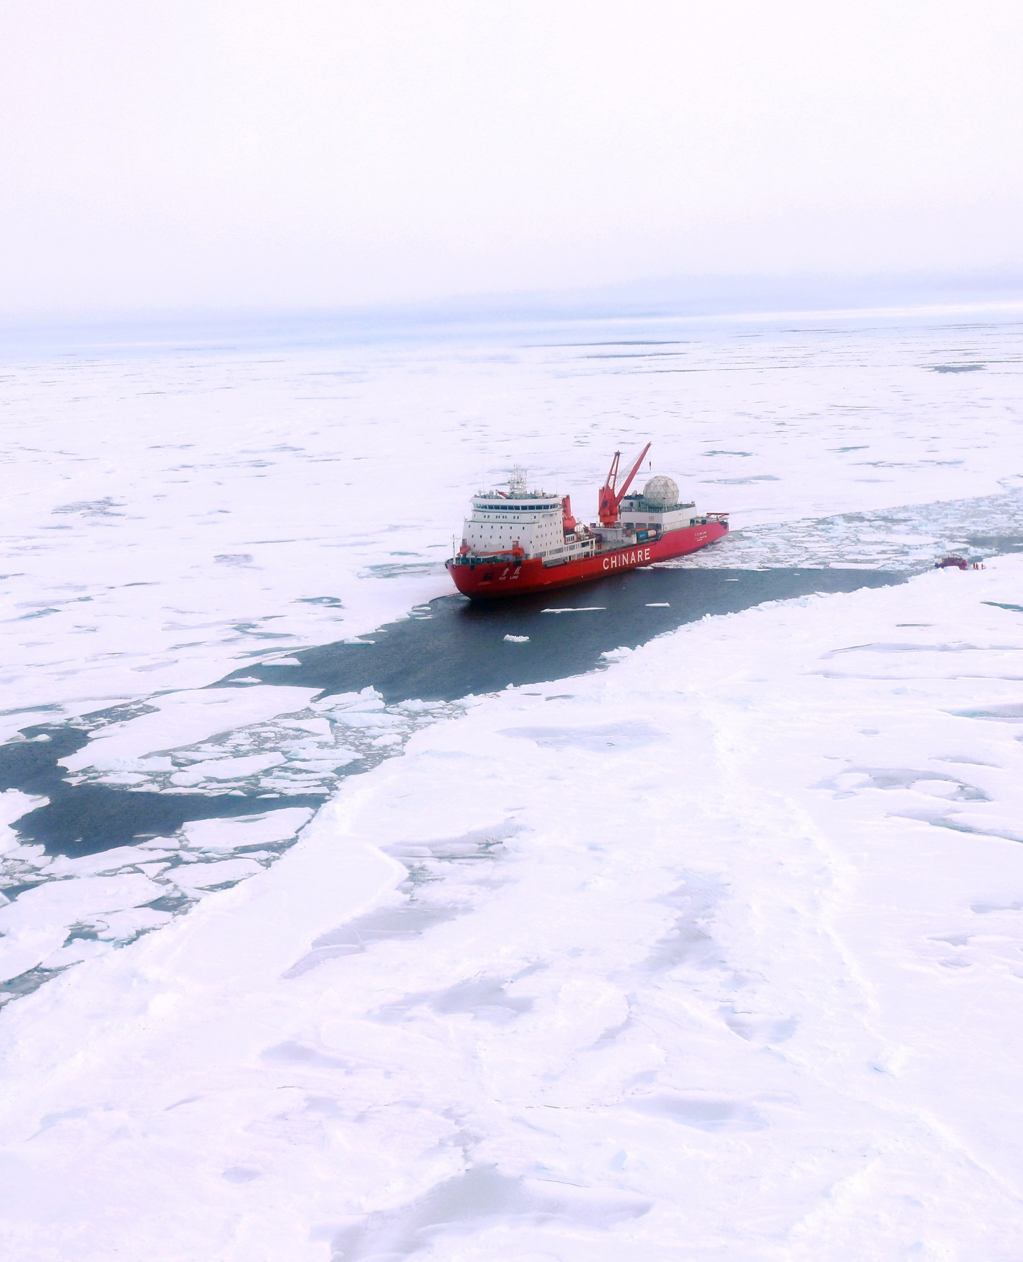
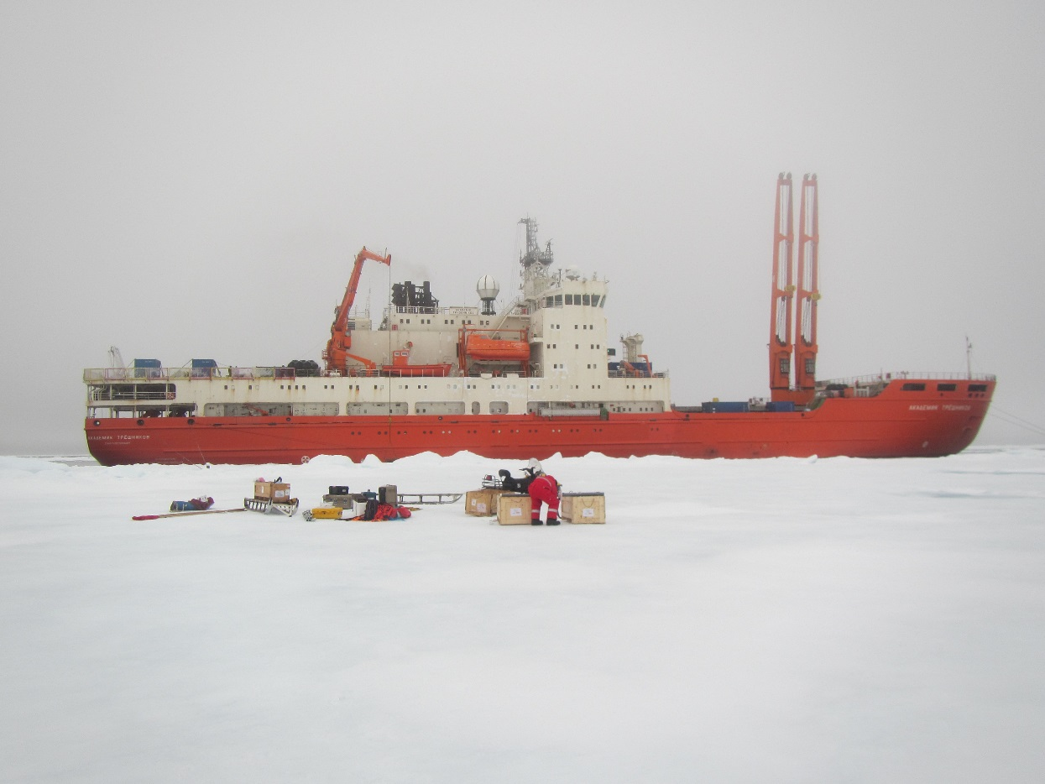
High-resolution Snow and Ice Mass Balance Array(SIMBA)
©CHINARE2018
Chinese National Arctic Research Expedition
© MOSAiC2019
©CAATEX2019
The Coordinated Arctic Acoustic
Thermometry Experiment
©NABOS2018
Nansen and Amundsen Basins Observational System
Notes:
Several international Arctic field campaigns have been carried out in the past few years.

Slide 8
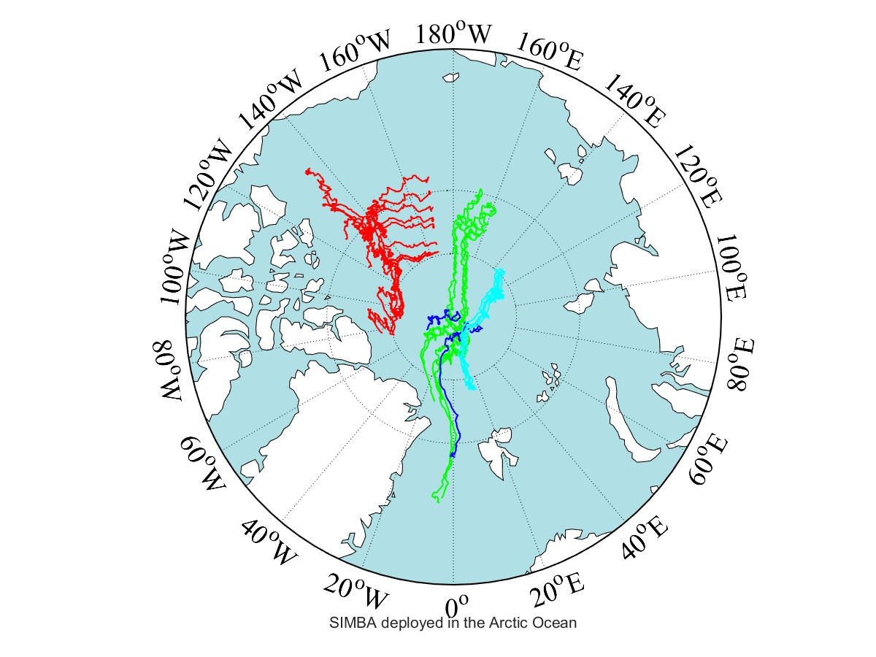
CHINARE2018 (mid-August)
North of Chukchi Sea and Beaufort Sea:
Mean Hice = 2.4m
Mean Hsnow = 0.06m
NOBAS2018 (mid-September)
East Siberian Sea:
Mean Hice = 2.3m
Mean Hsnow = ~0m
CAATEX2019 (late-August)
North Pole:
Mean Hice = 1.7m
Mean Hsnow = 0.06m
MOSAiC2019 (October)
North of Laptev Sea:
Mean Hice = 1 m
Mean Hsnow = 0.11m
SIMBA buoys drift trajectories
Notes:
The SIMBA buoys deployment and drift trajectories until early May 2020. The MOASiC deployments are largely active. For other deployment campaigns, only few SIMBA are still working.

Slide 9
Table was made on
12, November, 2019
33 SIMBAs buoys are listed here.
More SIMBA buoys will probably be deployed in the Arctic Ocean during MOSAiC leg 3/4, CHINARE2020
and other field campaigns.
Table was checked on 22, April, 2020
17 SIMBA buoys in the table are still working

Slide 10
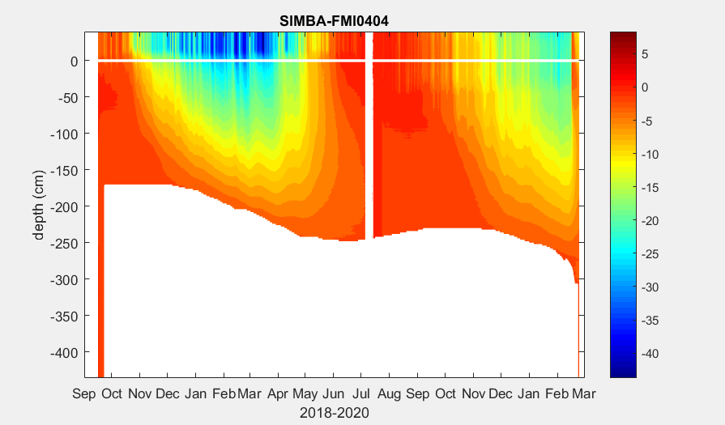
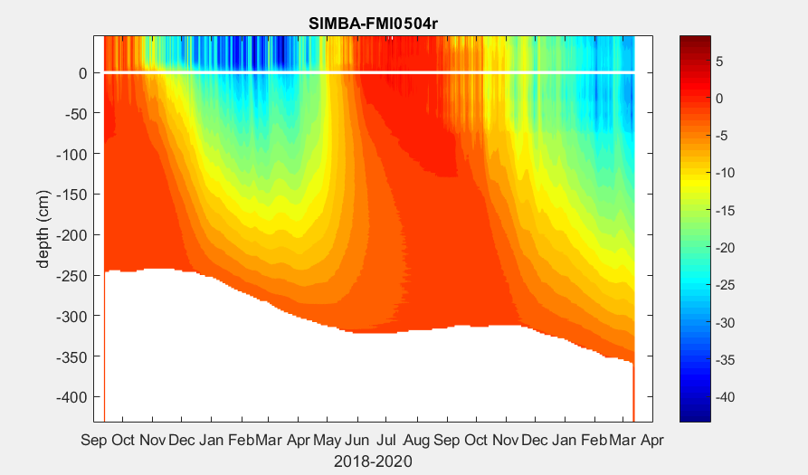
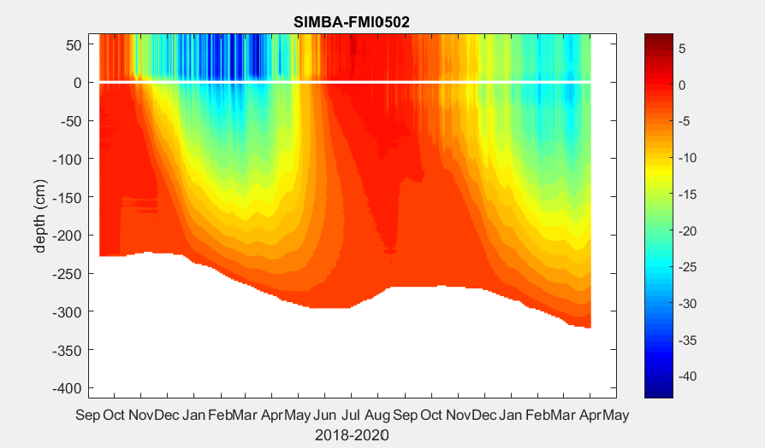
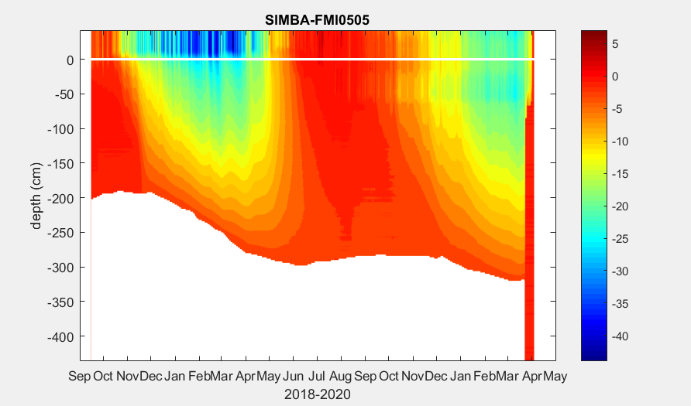
Notes:
SIMBA ice bottom evolution. Those SIMBAs were deployed during NOBAS field campaign in the East Siberian Sea. The white lines show the initial ice surface (valid until surface melting start in the melting season)

Slide 11
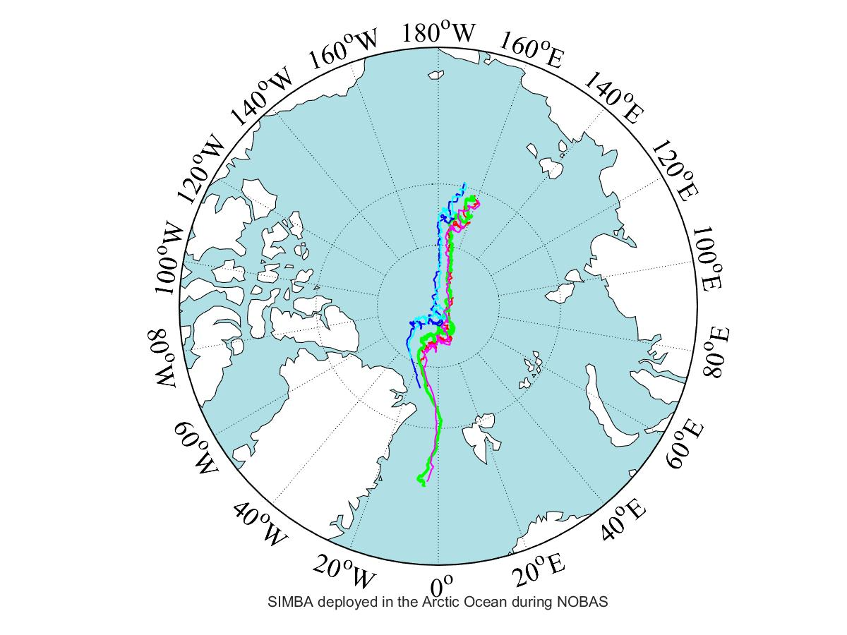
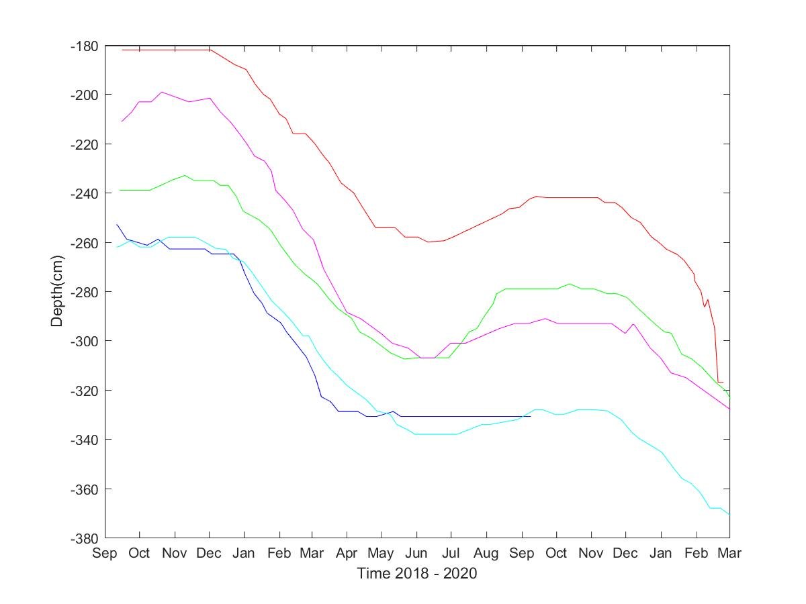
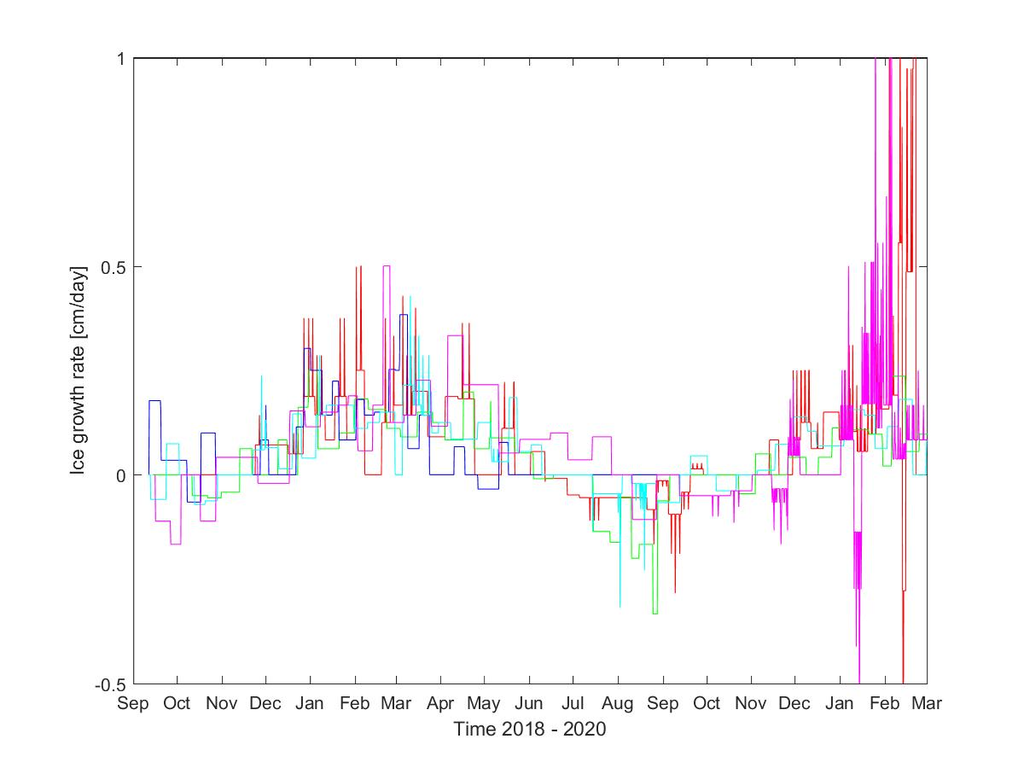
Bottom sea ice formation:
First winter:~
[70 cm - 110 cm]
Second winter:~
[40 cm - 70 cm]
SIMBA deployed during NABOS2018
Preliminary daily ice growth rate at ice bottom.

Slide 12
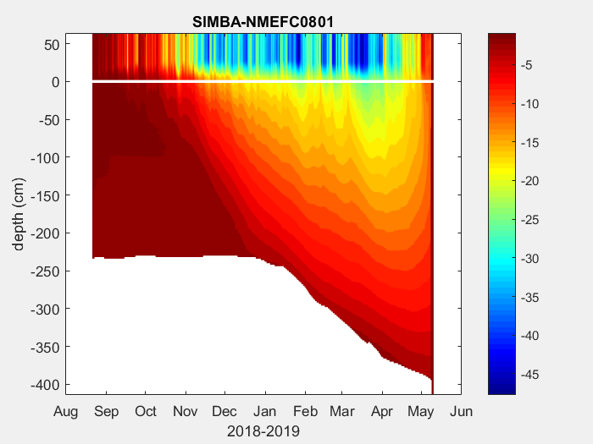
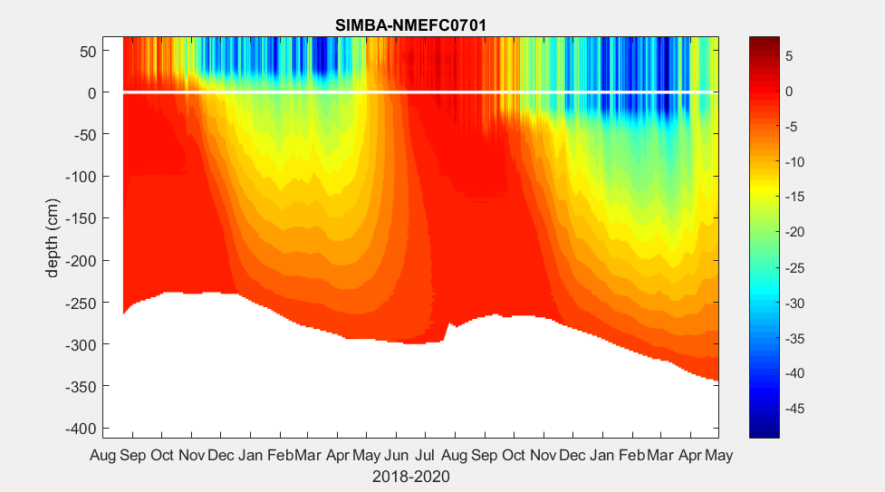
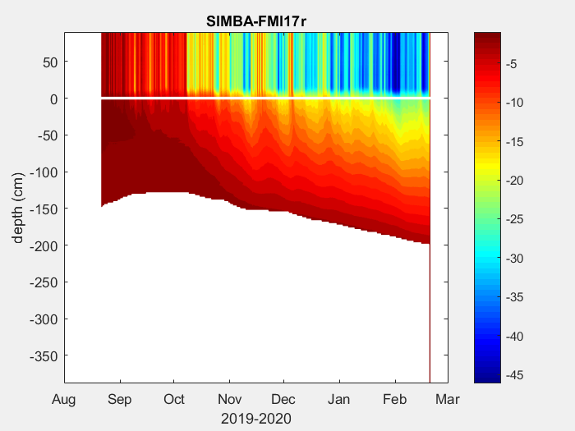
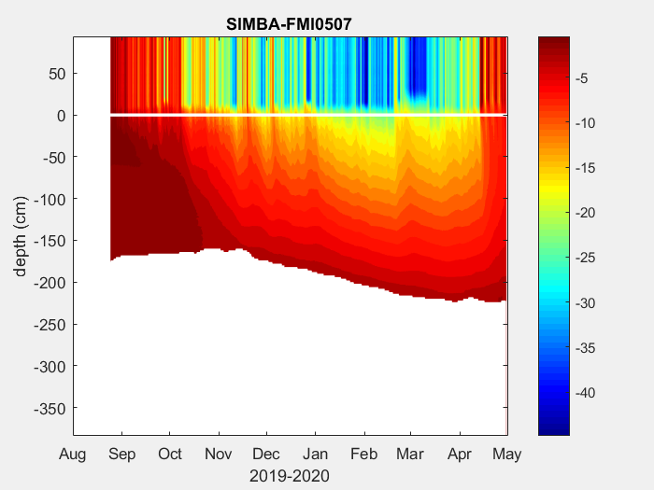
Notes:
Those are SIMBA buoys deployed during CHINARE2018 and CAATEX 2019. The white lines show the initial ice surface (valid until surface melting start in the melting season)

Slide 13
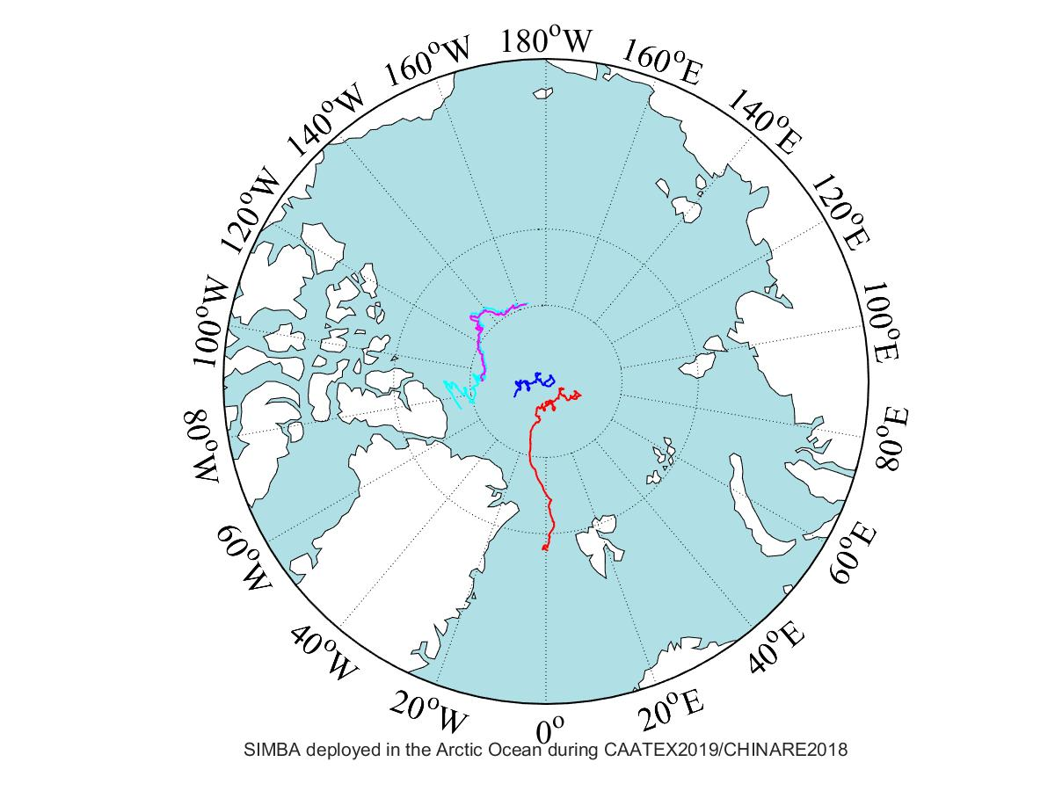
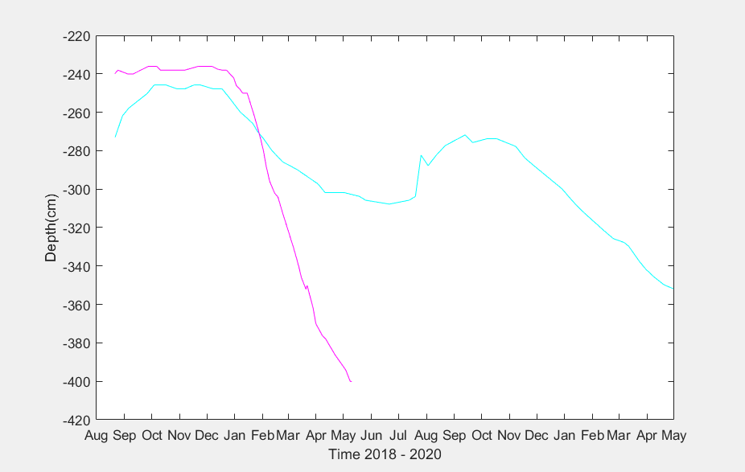
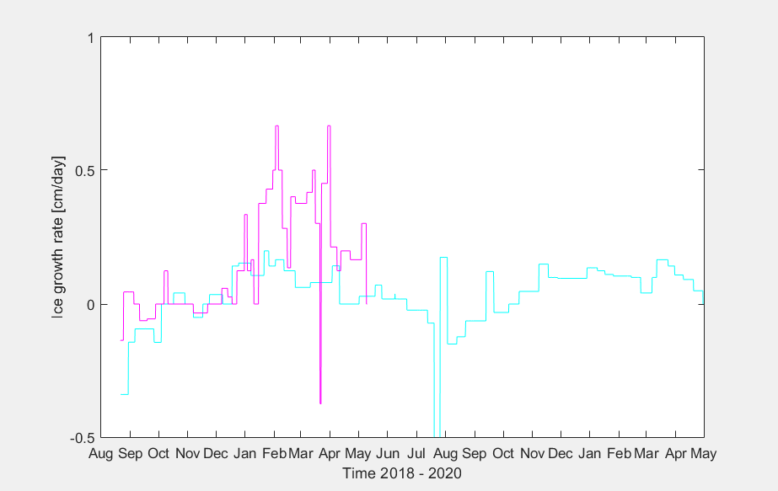
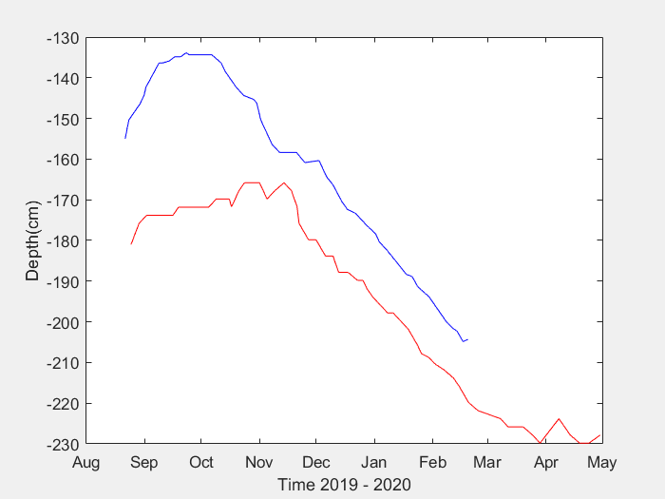
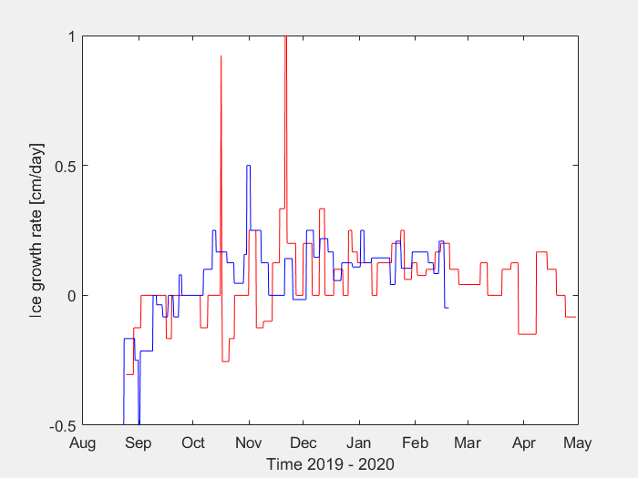
Two SIMBA deployed during CHINARE2018
CHINARE2018
60 cm
60 cm
160 cm?
CAATEX2019
Two SIMBA deployed during CAATEX2019
70 cm
60 cm

Slide 14
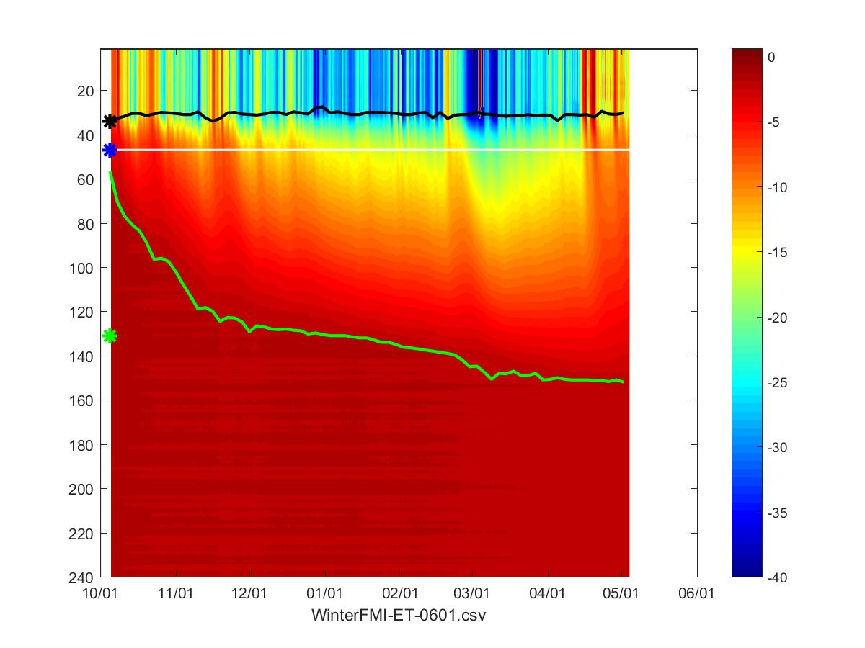
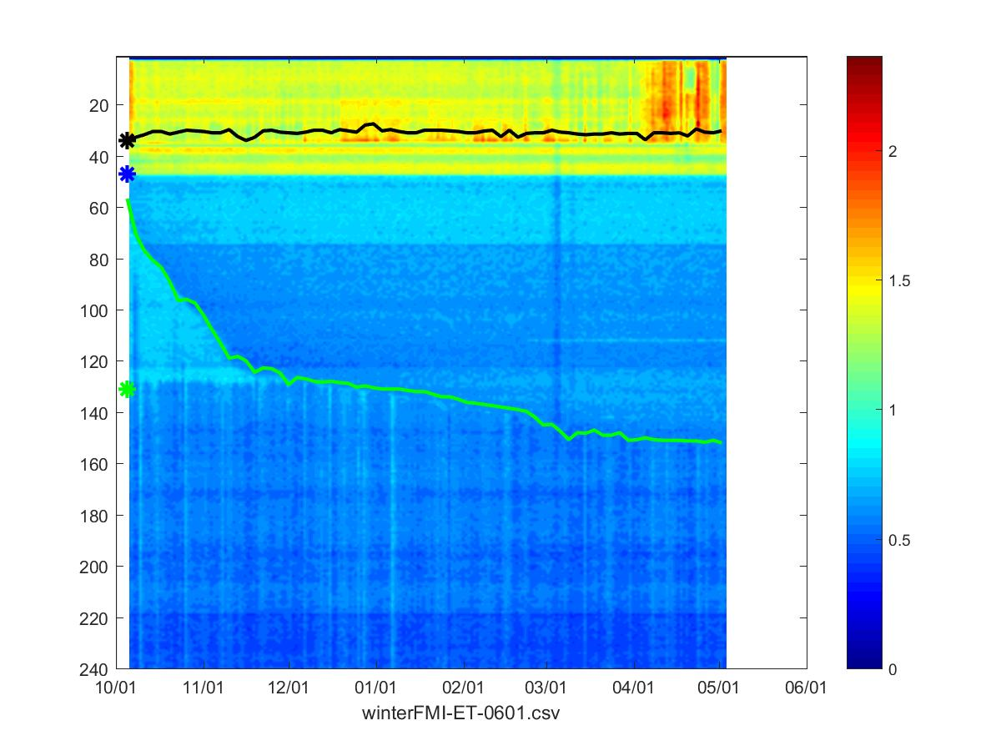
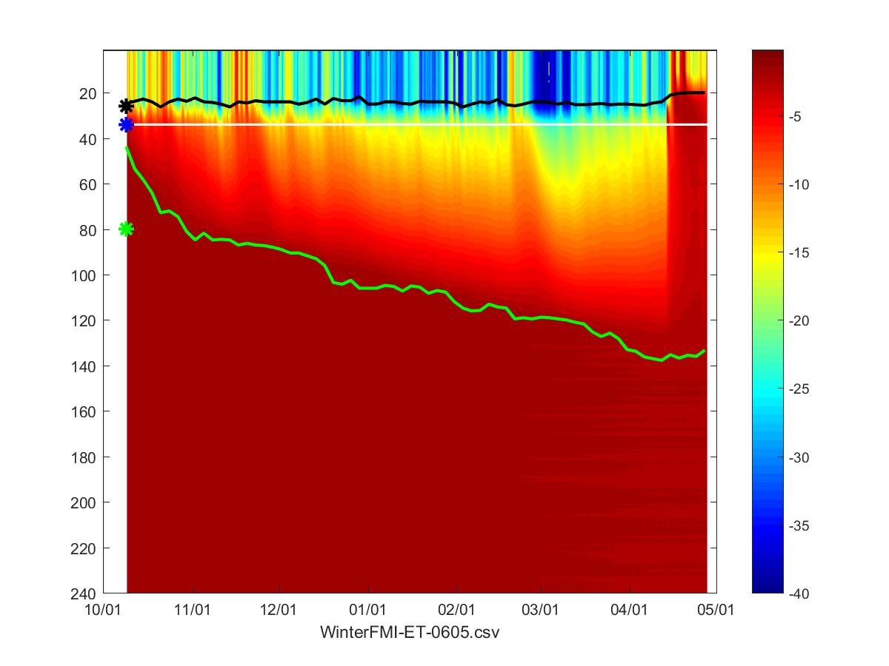
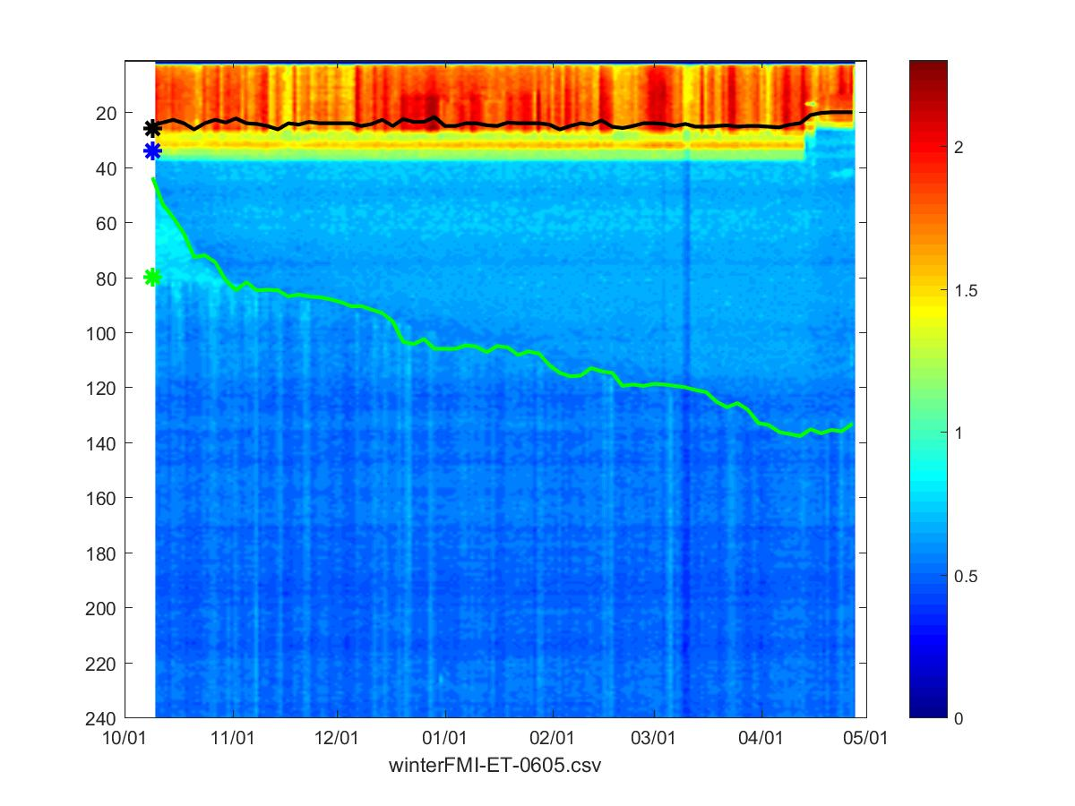
Two SIMBA buoys measurement during MOSAiC
Freezing up of the borehole is associated with initial ice thickness and weather condition
Freezing up is visible from HT field.
Initial snow depth = 15 cm
Initial ice thickness = 180 cm
FMI0601
Ice growth at bottom:
FMI0601: 40 cm
FMI0605: 115 cm
Ice thickness by early May:
FMI0601: ~220 cm
FMI0605: ~212 cm
Initial snow depth = 13 cm
Initial ice thickness = 97 cm
FMI0605

Slide 15
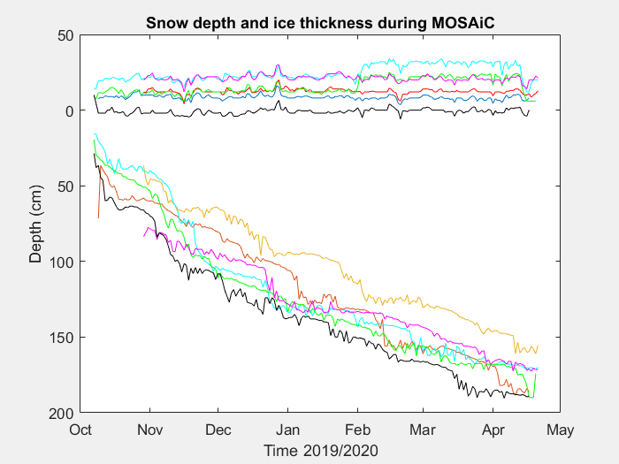
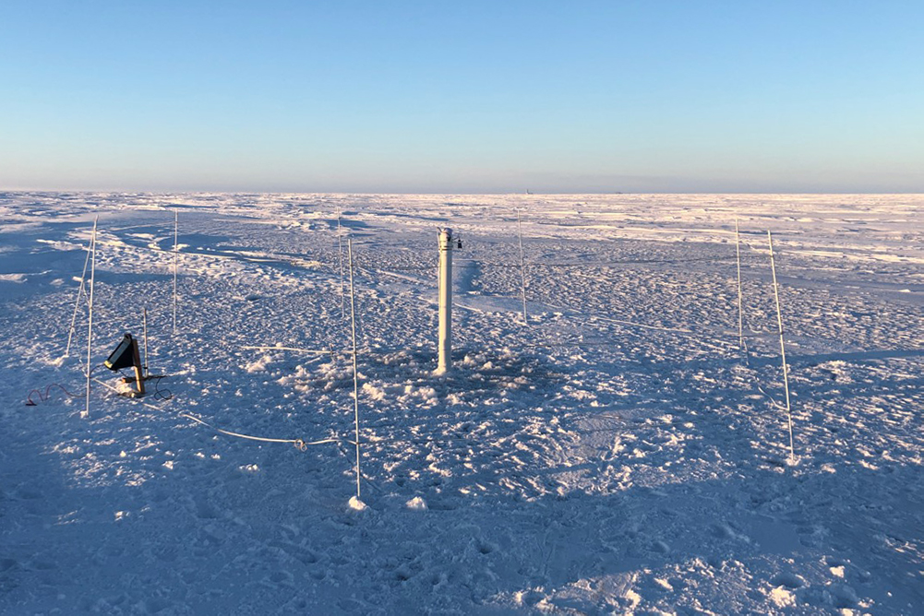
Snow depth and ice thickness derived from SIMBA_ET/HT. The results are comparable with CRREL-SIMB3 snow and ice thickness.
© CRREL-SIMB3
15

Slide 16
Summary
Snow and Ice Mass Balance Array (SIMBA) buoys have been deployed in the Arctic Ocean and hopefully will continue to be deployed in the coming seasons.
A SIMBA-algorithm can retrieve snow depth and ice thickness from SIMBA ET and HT measurements reasonable well. In cold condition, the results are comparable with the results from CRREL-SIMB3 (seasonal ice mass balance buoy equipped with acoustic sounders).
The SIMBA HT fields are more visible for ice bottom detection.
Winter ice bottom growth rate: 0.2 - 0.35 cm/day.
The variation of ice growth at bottom are associated with:
  SIMBA location (CHINARE2018, NOBAS2018)
  initial ice thickness (CHINARE2018, NOBAS2018, CAATEX 2018, MOSAiC)
  oceanic heat flux (To Be Investigated)
  snow condition (TBI)

