Slide 1

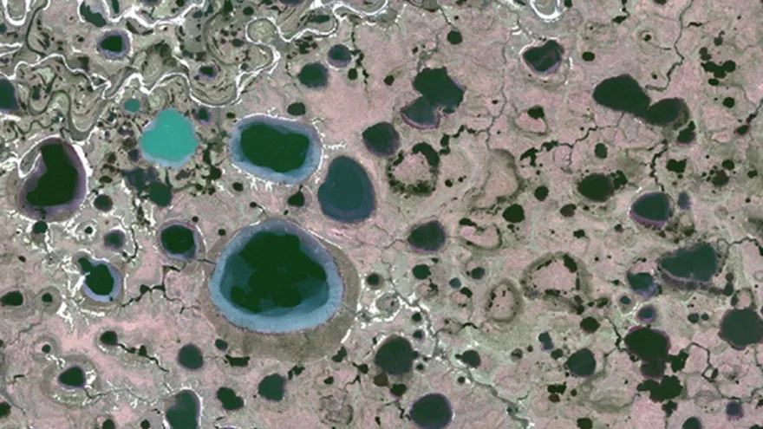
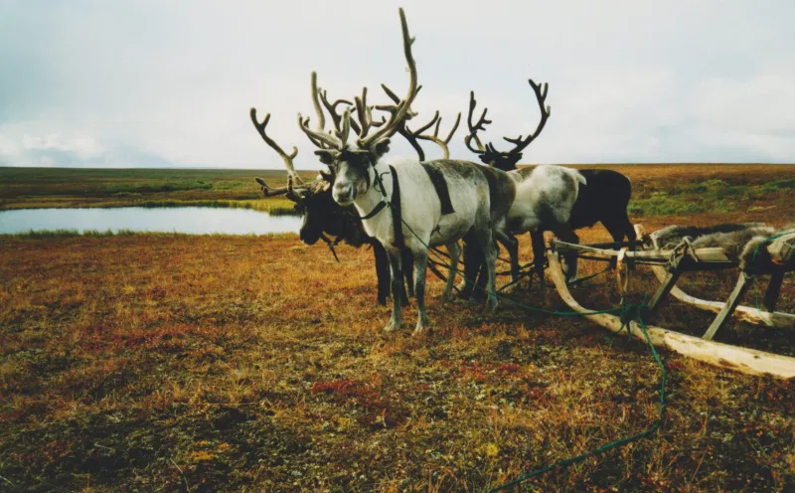
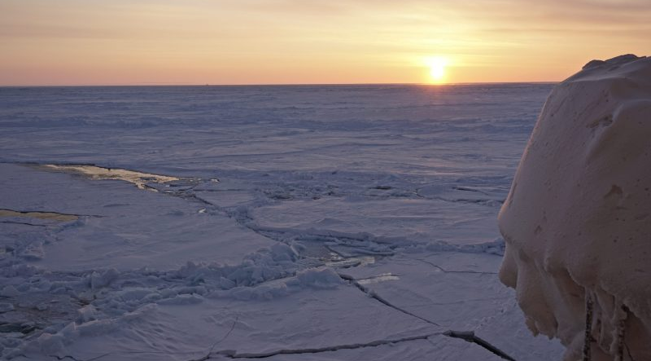

DRIVERS AND FEEDBACKS OF CHANGES IN ARCTIC TERRESTRIAL BIODIVERSITY
www.charter-arctic.org
CHARTER intends to advance the adaptive capacity of Arctic communities to climatic and biodiversity changes. The project has three central aims:
Better understand past and ongoing responses of Arctic terrestrial social-ecological systems to cryosphere changes
Simulate future effects of climate and social-ecological changes for indigenous and local communities and traditional livelihoods out to 2050
Work with Arctic communities to co-develop strategies and policy pathways for livelihoods eg herding, hunting and fishing

Slide 2




















22 research institutions
9 countries

Slide 3

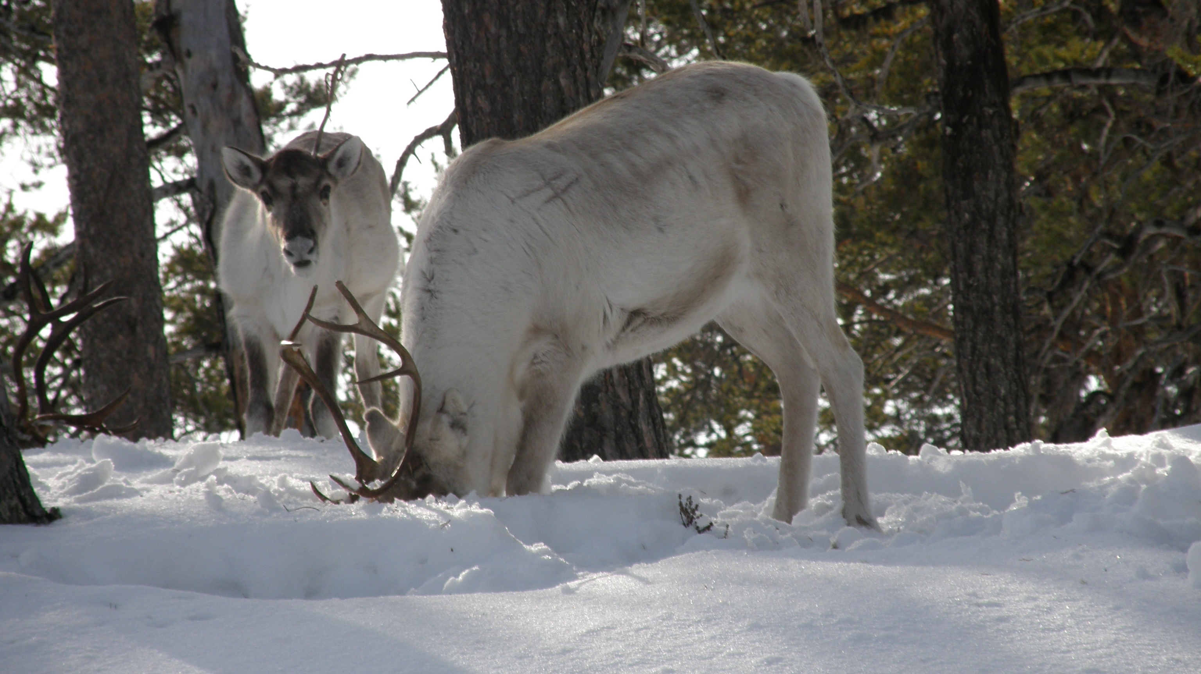
What impacts do reindeer have on their environment?
grazing: impacts on species composition and abundance
trampling: disturbing snow, disturbing vegetation
photo by Minna Turunen

Slide 4
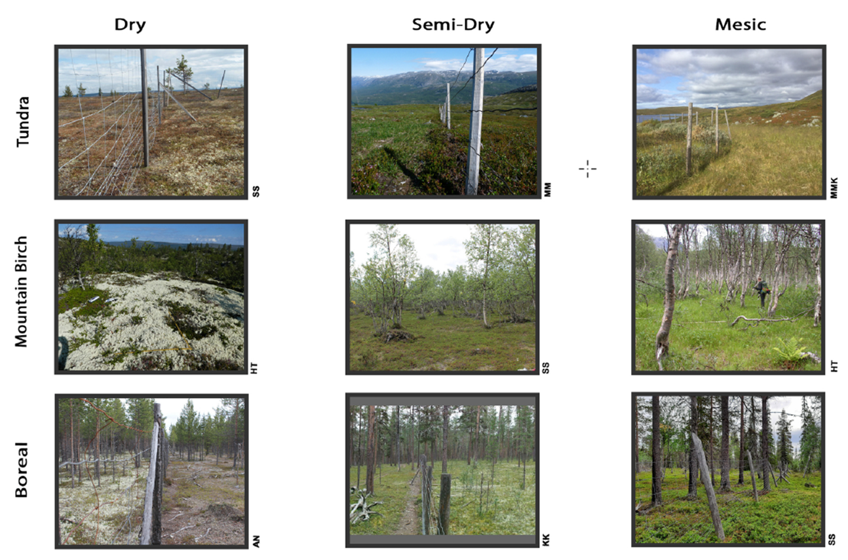
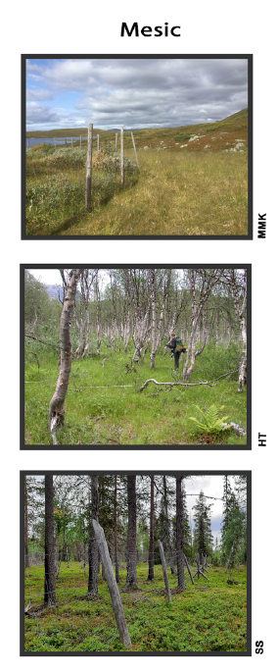
grazing & trampling: impacts on species composition and abundance, snow density
influence of reindeer on vegetation are complex and depend on the ecosystem
a number of effects seem to be common: exclosure sites have
  more shrubs, more lichen
  thicker organic soil layers (with similar carbon storage)
  lower snow density (higher snow depth with the same amount of snow water equivalent)
Stark et al., 2023, doi: 10.1016/j.ppees.2022.125716

Slide 5
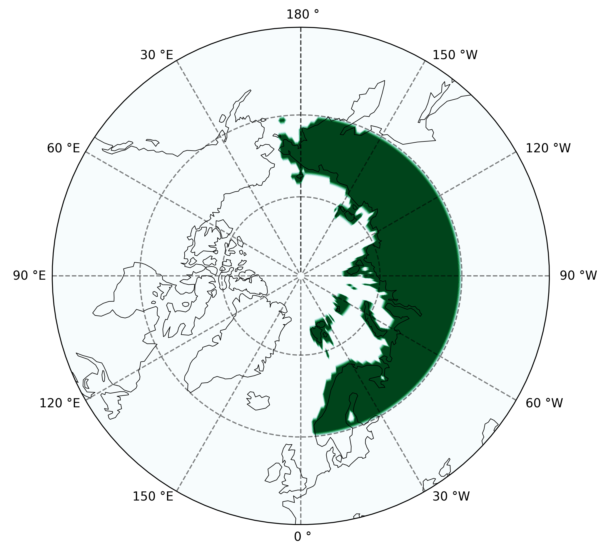
What could increasing the number of reindeer potentially mean for the future?
we designed a model experiment, using a global earth system model, to investigate what effects increased grazing and trampling might have on a projection of future Arctic climate
two different simulations looking at the impacts of trampling and grazing seperately
focus is on the cryosphere
The ‘Reindeer
Management ’ region
Grazing Experiment (GRAZING)
Trampling Experiment (TRAMPLING)
Shift of vegetation in the model towards smaller shrub abundance
Increase snow compaction rate by 50%
Remove biomass (shrub & grass) based on the amounts of food needed in reindeer herding
Decrease the fully saturated layer thickness by 50%
Chen et al., in prep.

Slide 6
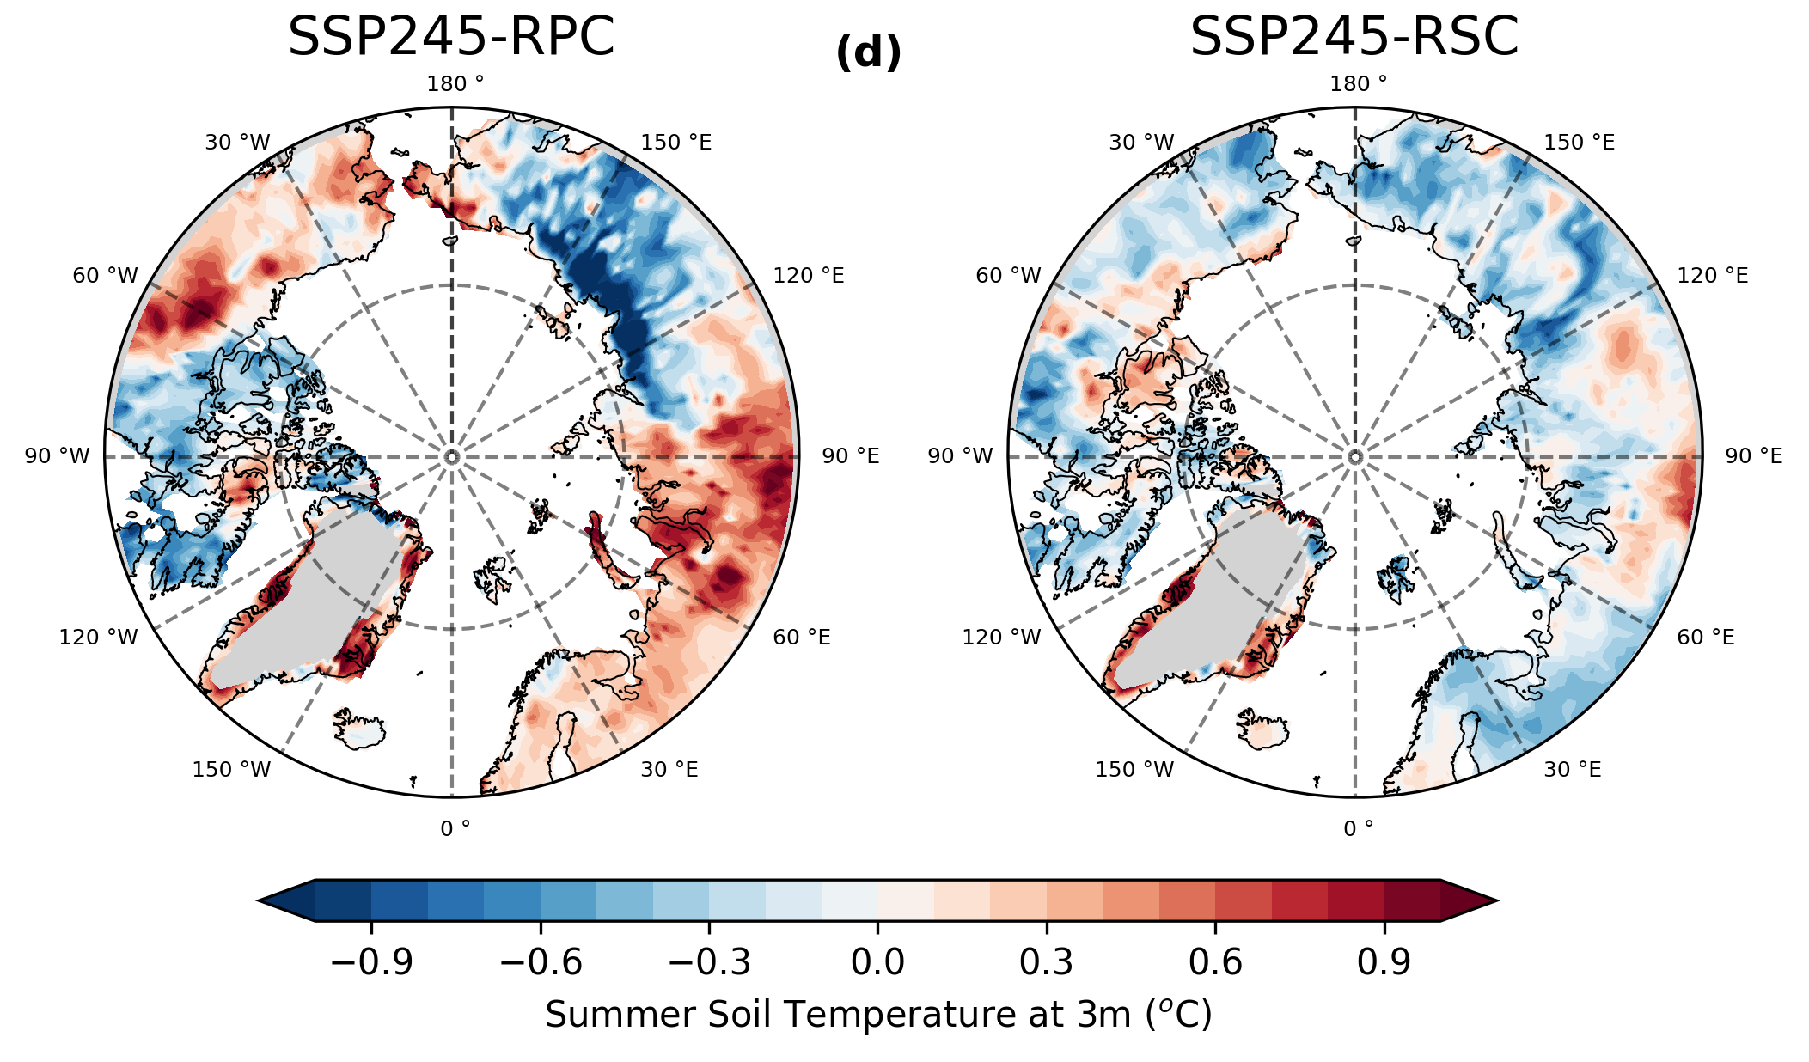
Impacts of changes in reindeer numbers on the cryosphere
GRAZING
TRAMPLING
Global Warming Level 2.5°C (SSP2-RCP4.5), difference at the end of the 21st century
Chen et al., in prep.

Slide 7
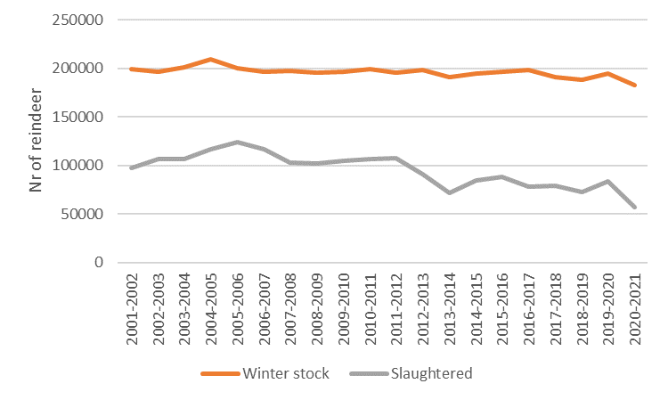
What does this mean for reindeer herders?
Good news: reindeer can mitigate some of the impacts of climate change on the cryosphere
Bad news: climate change causes compound events (bad conditions in consecutive seasons) whose impacts herders cannot compensate
Rasmus et al., 2024, submitted to PNAS
winter stock and slaughtered reindeer in Finland (all herding districts combined)

Slide 8
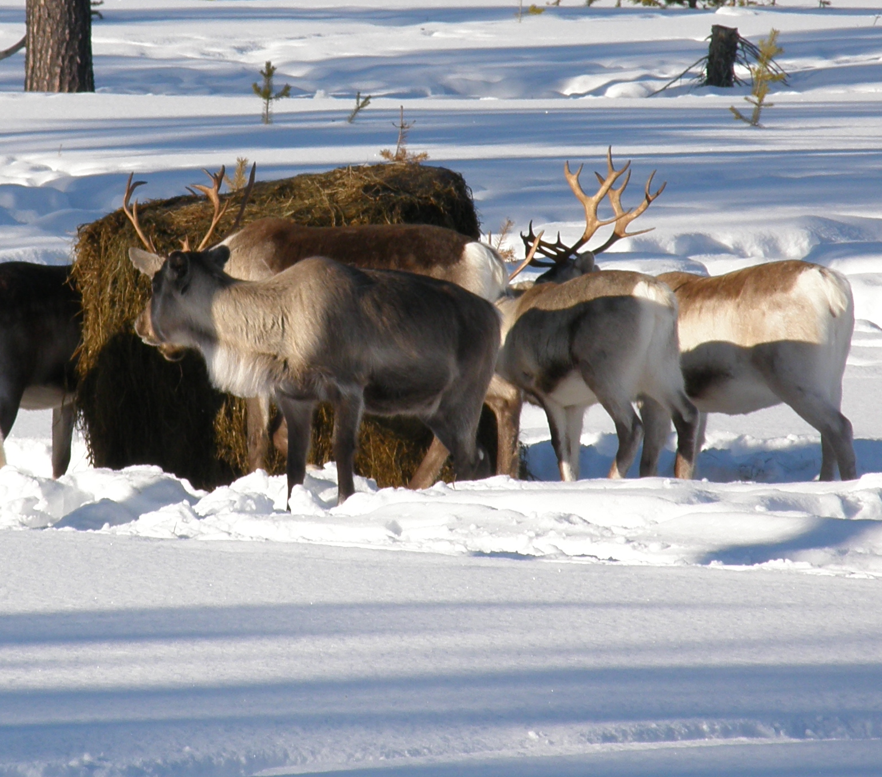
What does this mean for reindeer herders?
adaptation to current conditions is what reindeer herding is all about, so herders are well versed in adaptation
new challenges might need new adaptation strategies
in co-creation with herders, we identified conditions throughout the year that make it un/successful
providing herders with information about how these conditions might change in the future can help develop new adaptation strategies
photo by Minna Turunen

Slide 9
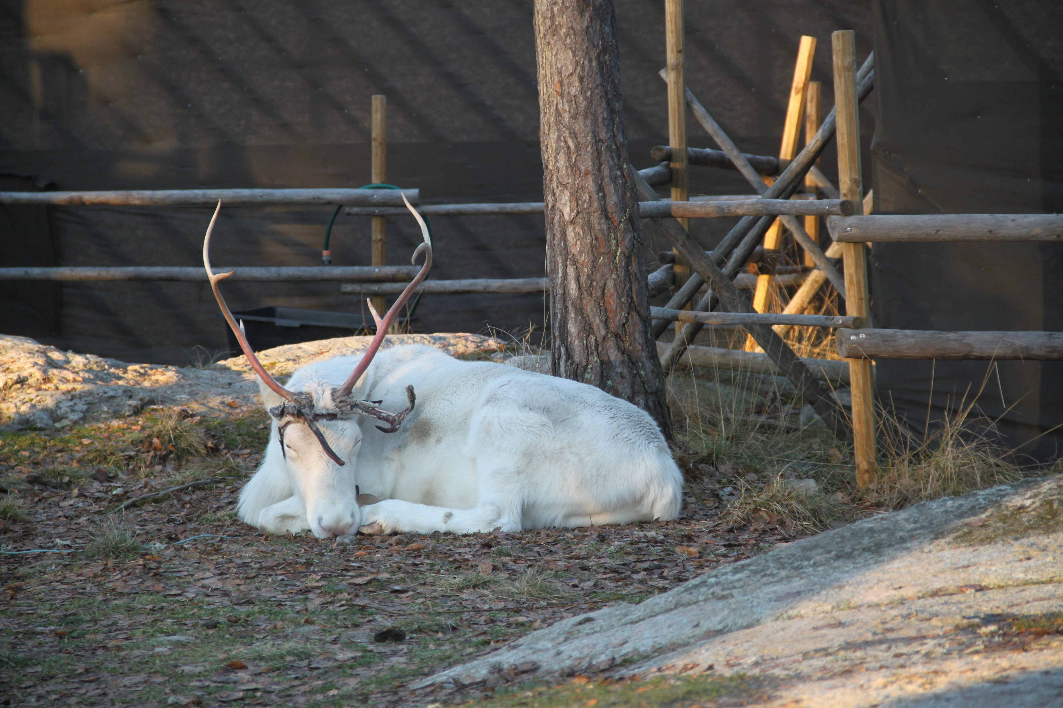
questions?

